Slide 1

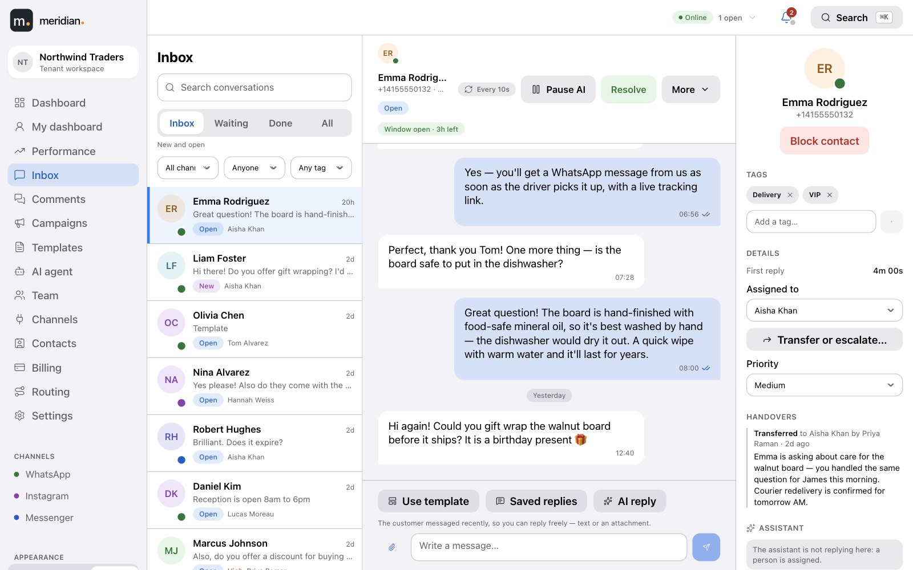
Meridian
1
Inbox
PRODUCT TOUR
One inbox for WhatsApp, Instagram and Messenger.
Every customer message and comment, from every Meta channel, handled by your team as tickets — with an AI agent that answers from your own material, plus contacts, templates, campaigns and reporting built in.
WhatsApp
Instagram
Messenger
AI agent
Notes:
Meridian brings every WhatsApp, Instagram and Facebook conversation — and Instagram and Facebook comments — into one inbox, organised as tickets for your support team, with an AI agent that can answer first and hand over to a person.

Slide 2









Meridian
2
AT A GLANCE
Everything your support team needs, in one place.
Unified inbox
Tickets, not just threads
An AI agent — new
WhatsApp, Instagram DMs and Messenger side by side, plus Instagram and Facebook comments.
Every conversation has a status, a priority, tags, internal notes and an owner.
Answers in your voice from your own material, and hands over to a person when it should.
Your team, organised
Contacts — new
Templates & campaigns
Presence, queues, automatic routing, workload limits, transfers, escalation and saved replies.
One profile per customer across channels, with custom fields, import, export and blocking.
Create templates, track Meta approval, and send to thousands on a schedule and at a speed you control.
Real-time
Reports & agent performance
Transparent billing
New messages, delivery updates and assignments appear for everyone instantly — no refreshing.
Volumes and response times, plus a leaderboard and a drill-down for every agent.
A clear statement of every message and every AI reply, paid from one balance.
Notes:
Nine things the customer gets. Each is a later slide; the AI agent and contacts are new.

Slide 3
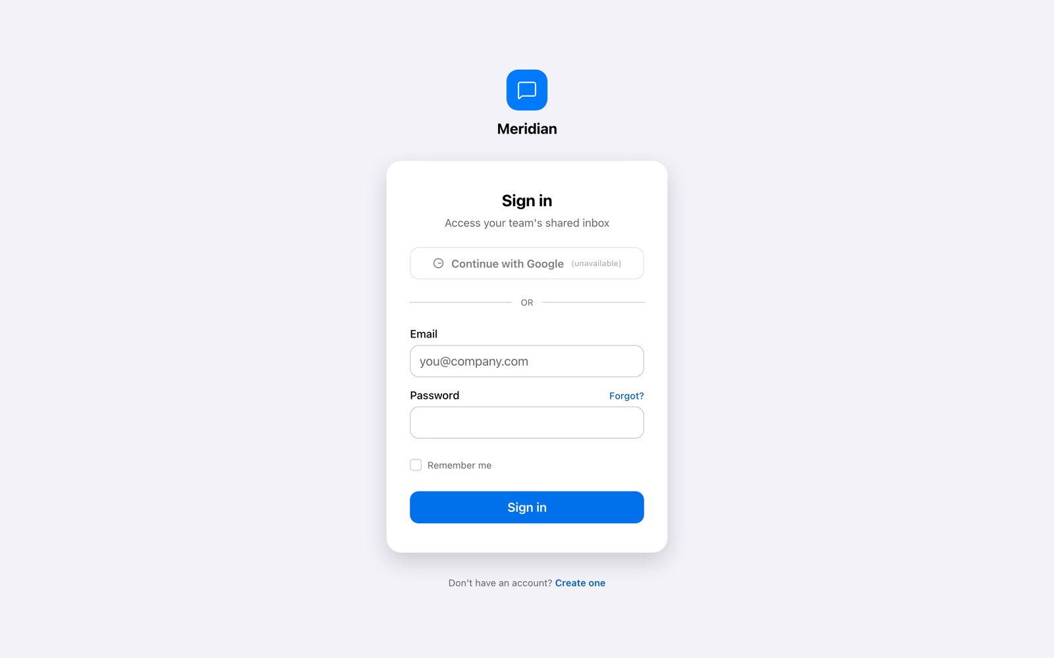
Meridian
3
GETTING IN
Sign in with Google, or email and password.
Sign in
Two-factor authentication is available for any account, with single-use recovery codes. Invite teammates by email; each arrives with the role you chose.
Google sign-in
Email & password
Two-factor (TOTP)
Notes:
Sign-in options and two-factor authentication.

Slide 4
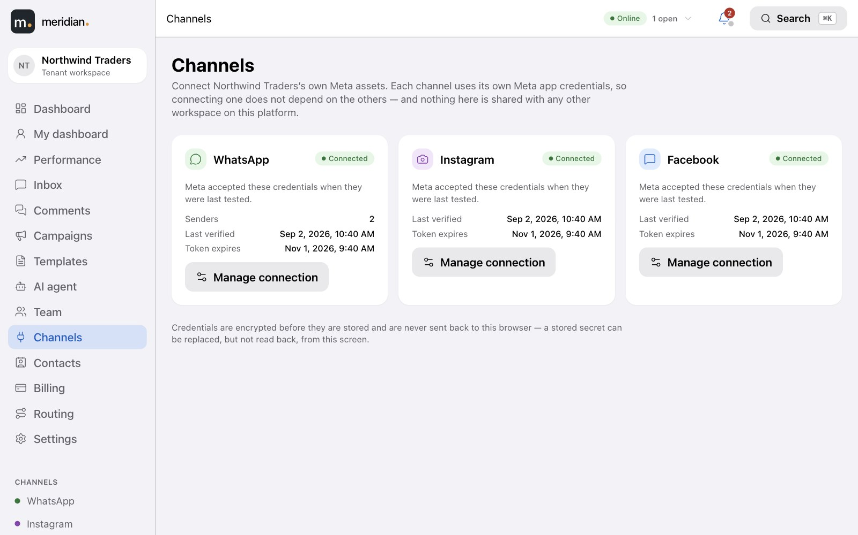

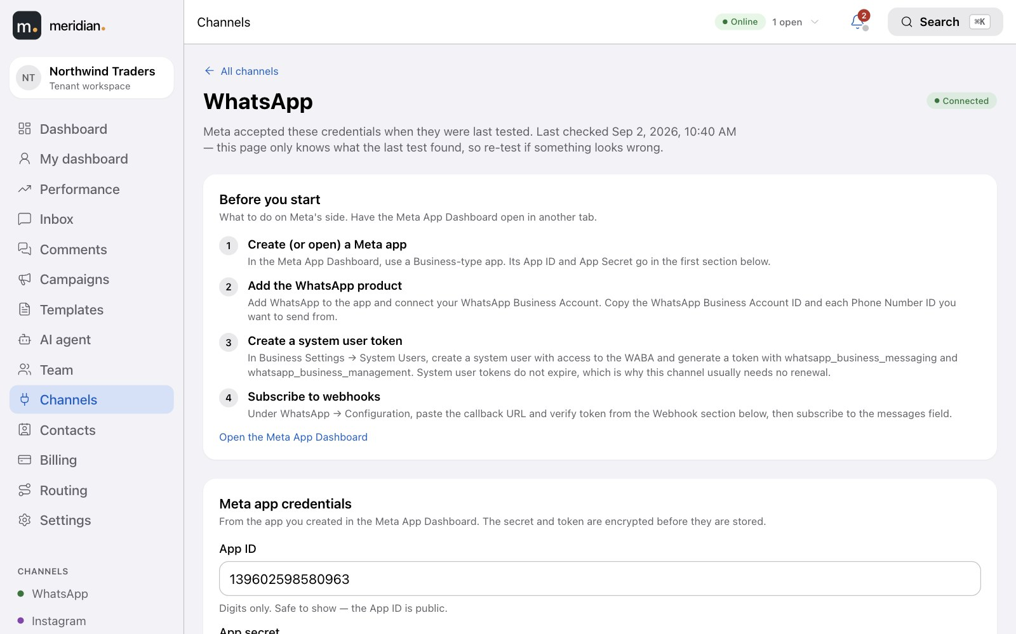
Meridian
4
Settings · Channels
SETUP
Connect your own Meta accounts in minutes.
A guided setup for each channel — your WhatsApp Business Account, Instagram business account and Facebook Page. Add more than one WhatsApp number if you need to.
Connection status per channel — checked automatically, with a clear warning if a token is about to expire.
Settings · WhatsApp
Your credentials stay yours — stored encrypted, never shown again after you save them.
Copy-and-paste webhook details so the Meta side is done in one sitting.
Notes:
Each tenant connects their own WhatsApp Business Account, Instagram account and Facebook Page through a guided setup.

Slide 5
Meridian
5
THE INBOX
Every conversation, from every channel, in one list.
Inbox
Filter by status, channel, assignee or tag. Open a conversation and the whole history is there — with the customer's details and your team's notes beside it.
Channel at a glance — each conversation shows where it came from.
Unread counts and last message so the queue reads like a to-do list.
Search everything with ⌘K.
Notes:
The core screen. Three channels in one list; the conversation and the customer context beside it.

Slide 6
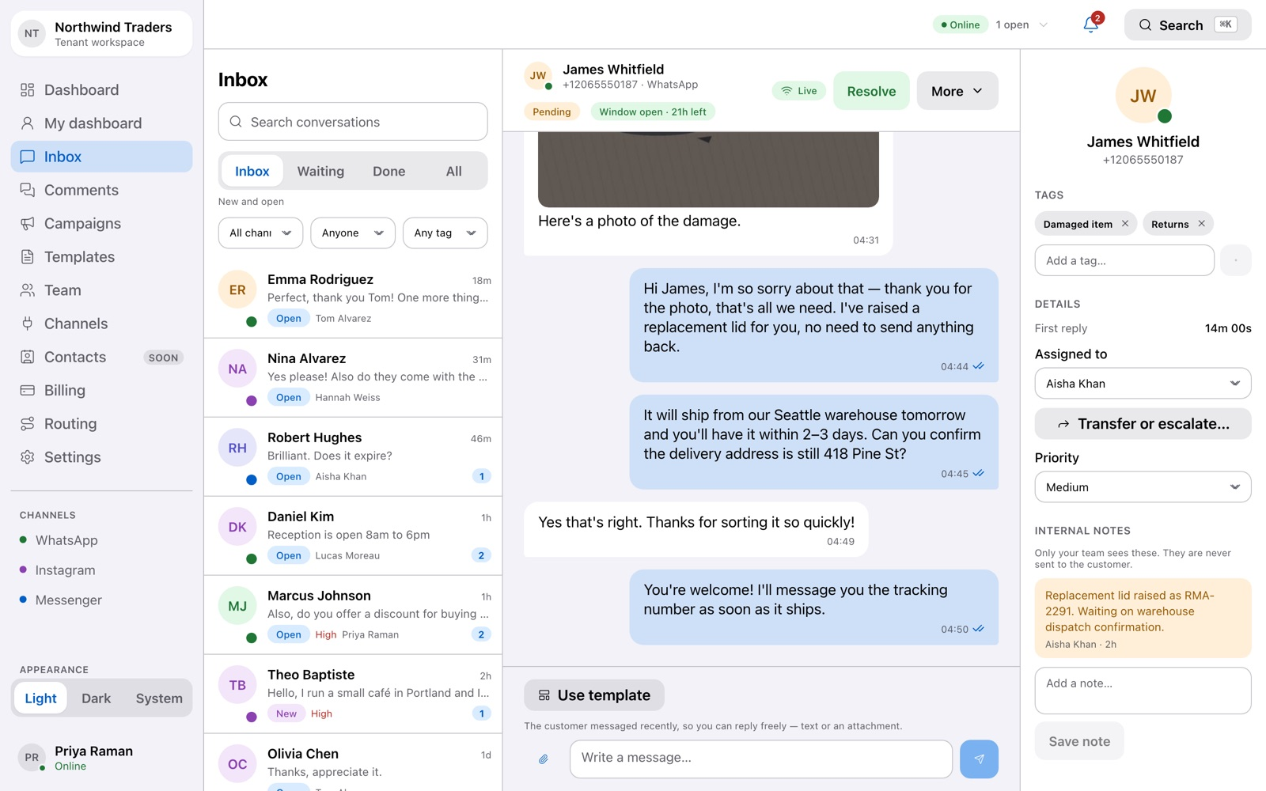
Meridian
6
TICKETS
Every conversation is a ticket with a life cycle.
Inbox · Conversation
Nothing gets lost in a thread. Each conversation moves through clear states, belongs to someone, and carries the context your team needs.
New
Open
Pending
Snoozed
Resolved
Closed
Priority, tags and an assignee on every ticket.
Internal notes only your team can see — never sent to the customer.
A customer reply reopens a resolved ticket automatically; after it's closed, a fresh ticket starts.
Notes:
Status lifecycle, priority, tags, internal notes and assignment.

Slide 7
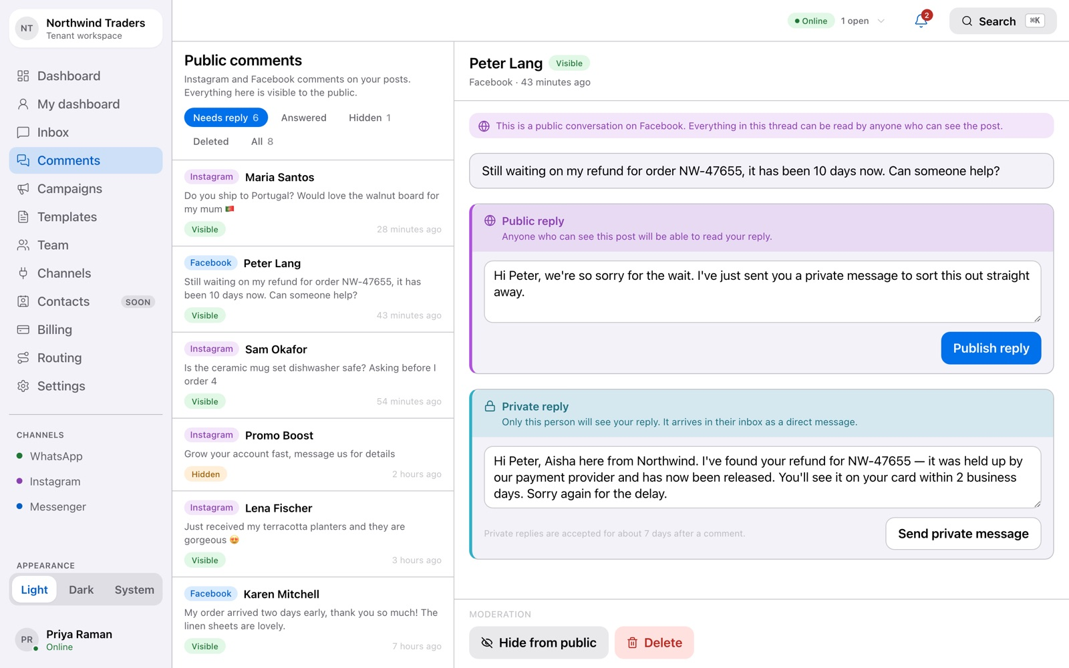
Meridian
7
COMMENTS
Comments, answered from the same place.
Comments
Instagram and Facebook comments arrive in their own queue, so nothing said in public goes unanswered.
Reply in public under the post, or send a private message to take it into the inbox.
Hide or delete spam and abuse with one click; hidden comments stay reviewable.
Needs reply, answered, hidden — filter the queue the way you filter tickets.
Notes:
Instagram and Facebook comments in a dedicated queue with public reply, private reply and moderation.

Slide 8
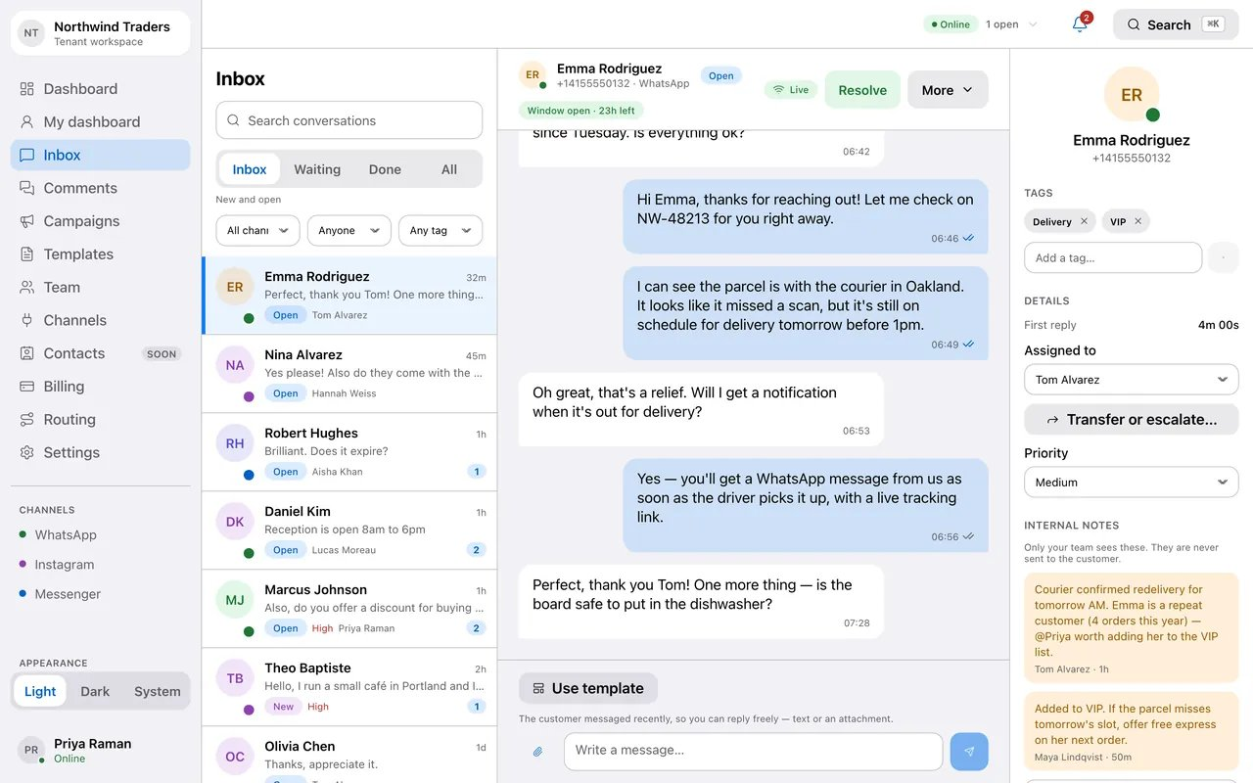
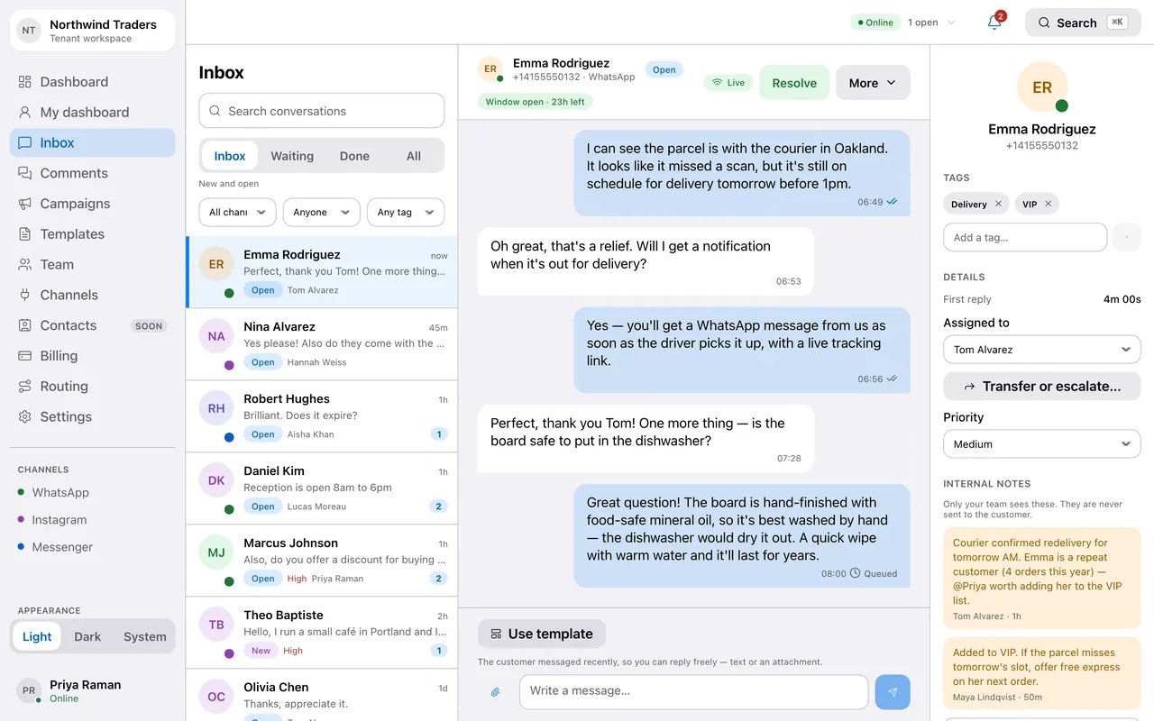
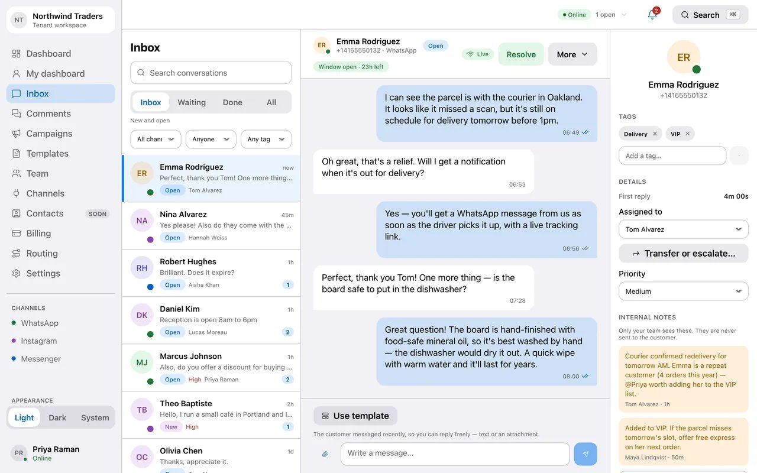
Meridian
8
SEE IT HAPPEN
From typed to read, in real time.
An agent sends a reply. It shows as queued, then Meta confirms it was sent, delivered and read — each tick appears the moment Meta reports it.
Composer
Sent
Read
1
The agent types a reply and sends it; it shows as queued.
2
Meta accepts the message: sent, then delivered.
3
The customer opens it: read, with the time.
Notes:
Frames captured from the running product. The web version of this deck plays the full animation.

Slide 9

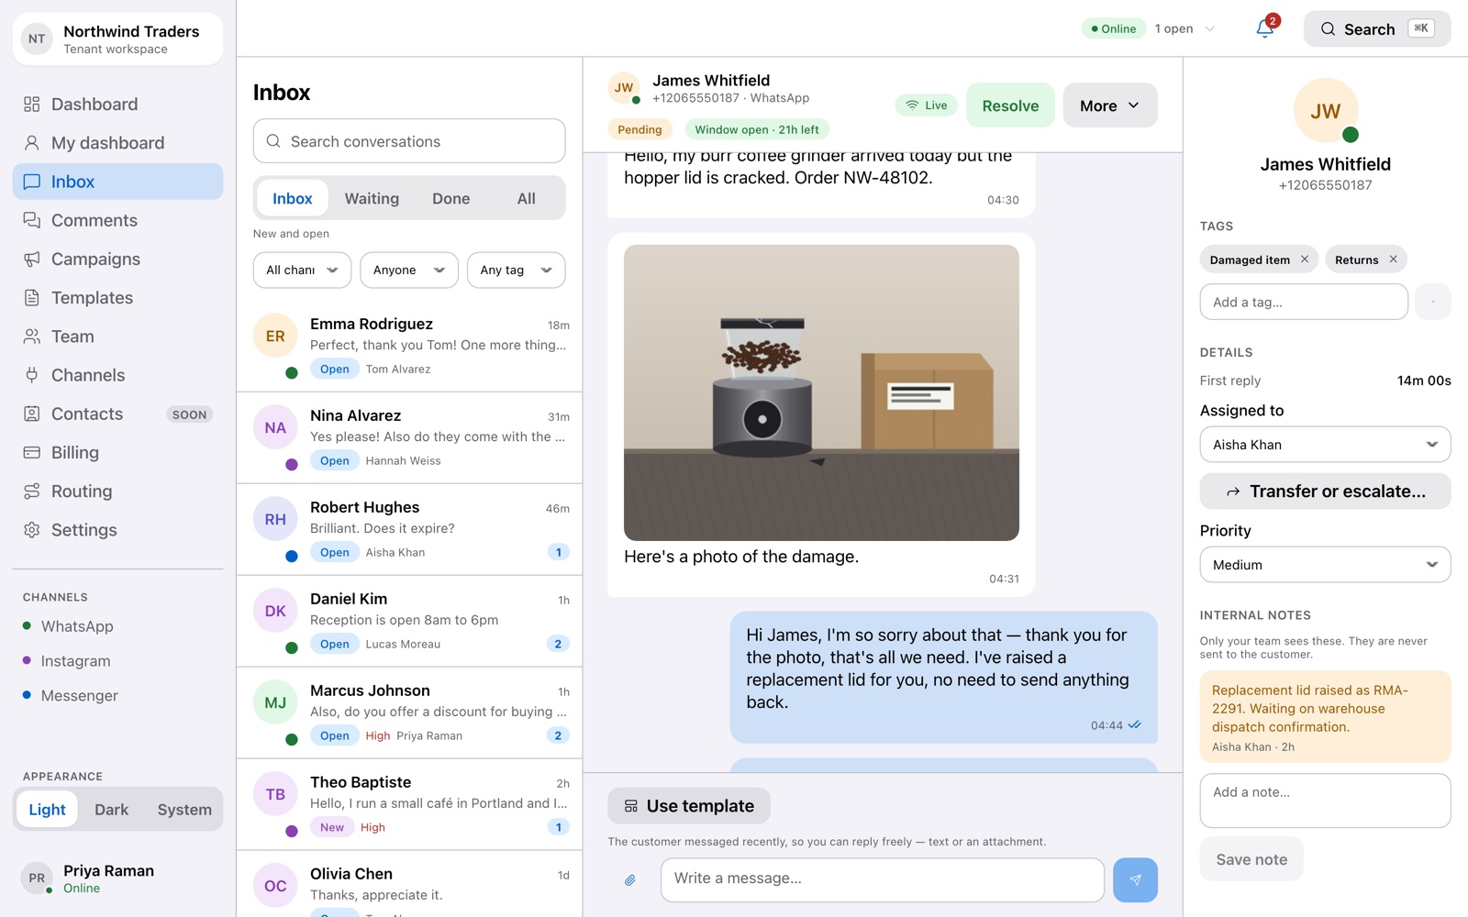
Meridian
9
REPLYING
Delivered
Know exactly where every message is.
Delivery status comes straight from Meta — queued, sent, delivered, read — so what you see is what actually happened, not a guess.
Photos and documents — receive them in the thread, and attach them to your replies.
Attachment
Reactions and read receipts shown where they belong.
If Meta rejects a message , you see why — not a silent failure.
Notes:
Delivery states are reported by Meta webhooks, not assumed after sending.

Slide 10
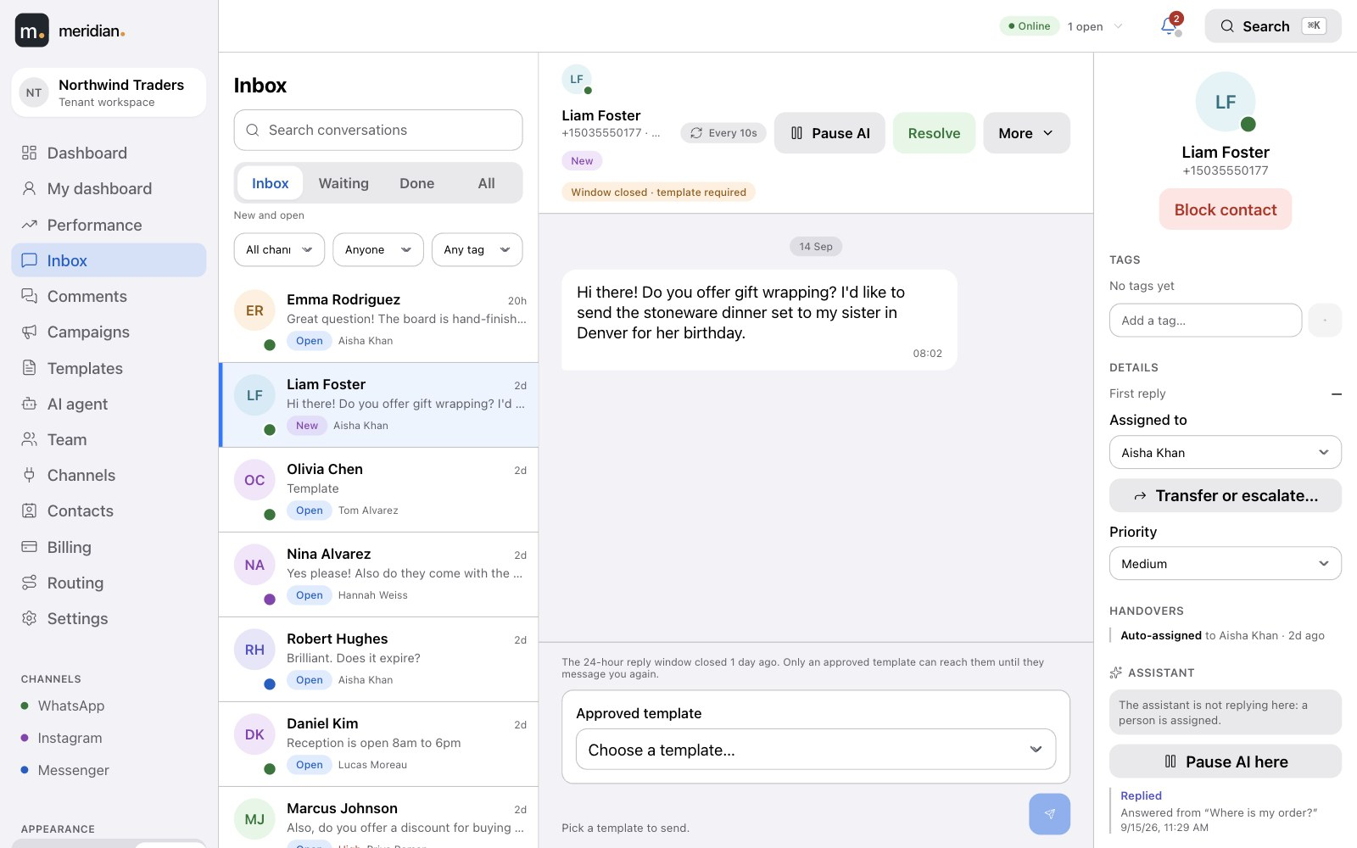
Meridian
10
COMPLIANCE, BUILT IN
The 24-hour rule, handled for you.
Composer · window closed
WhatsApp lets you reply freely for 24 hours after a customer writes in. After that, only an approved template can restart the conversation. Meridian knows which is which — so your team never has to.
Window open: type and send, attach files, use a template if you like.
Window closed: the composer offers your approved templates and nothing that would be rejected.
A countdown on every conversation shows how long the window has left.
Notes:
The composer enforces the WhatsApp 24-hour customer service window automatically.

Slide 11
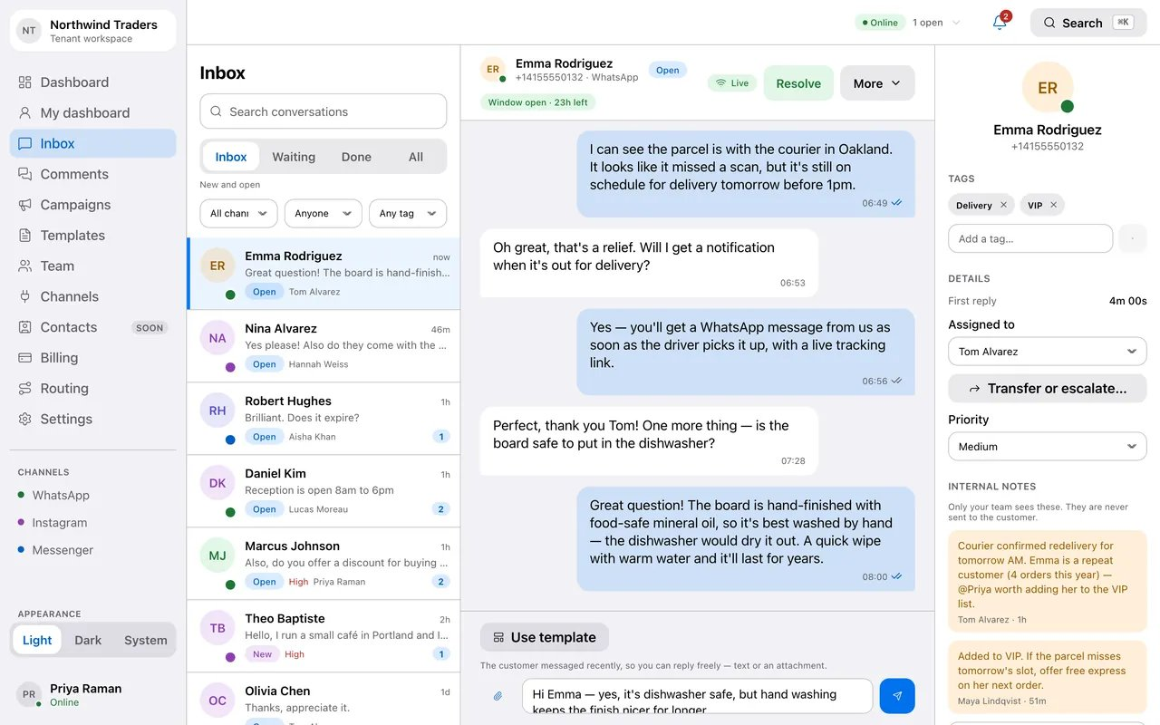
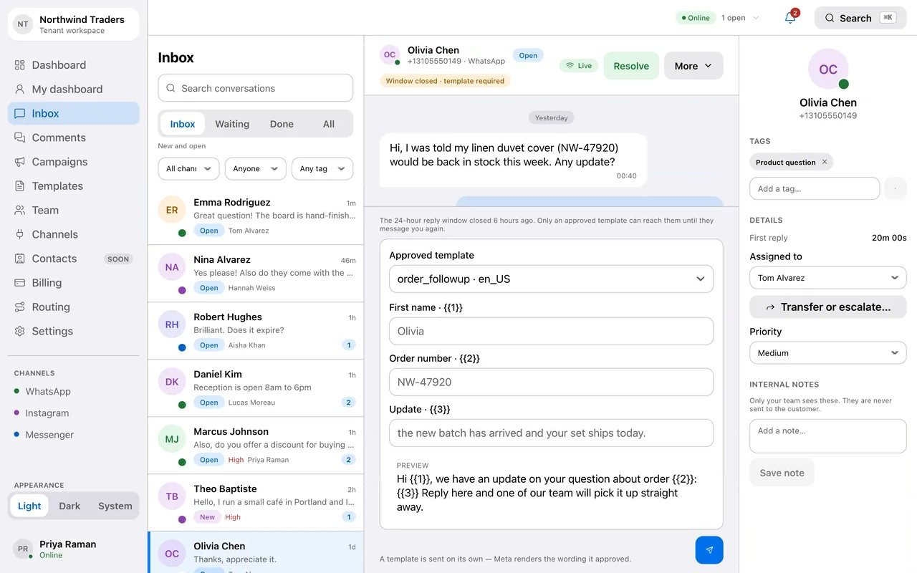
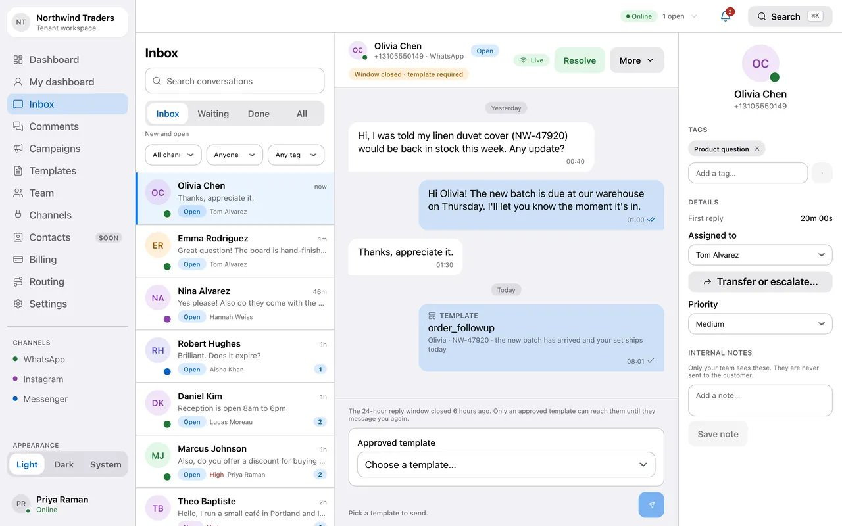
Meridian
11
SEE IT HAPPEN
The window closes. The composer adapts.
Free-text replies while the window is open; when it closes, the composer switches to approved templates, fills the variables with a live preview, and sends.
Window open
Window closed
Template sent
1
Inside 24 hours: type freely, attach files.
2
After 24 hours: only approved templates are offered; variables are filled with a live preview.
3
The template goes out and appears in the thread.
Notes:
Frames captured from the running product. The web version of this deck plays the full animation.

Slide 12
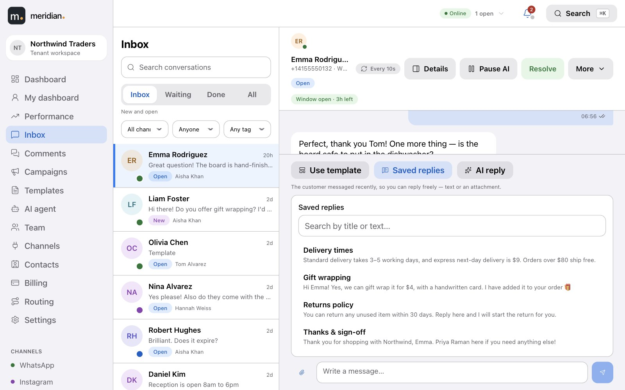
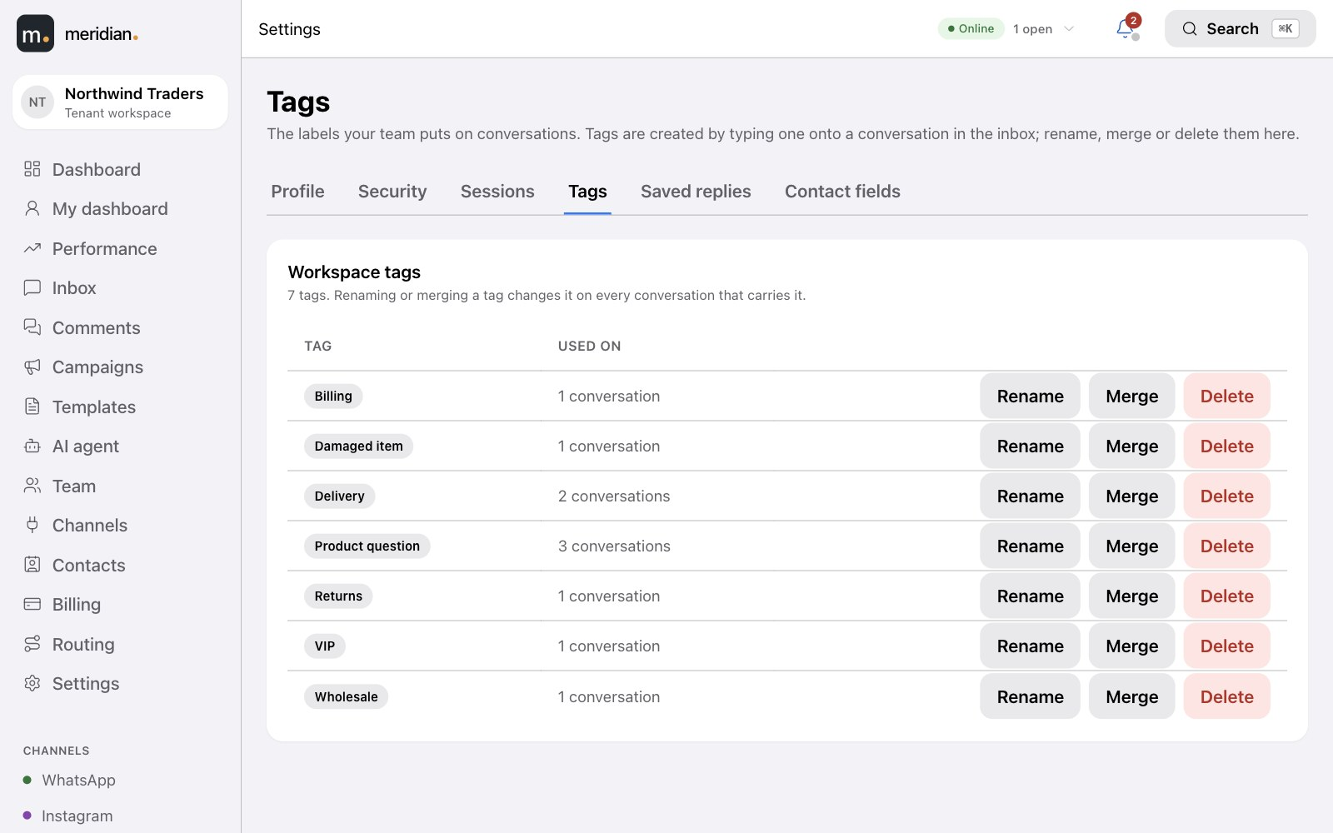
Meridian
12
Composer · Saved replies
ANSWER FASTER
The right words, one click away.
Admins write the answers your team gives every day, once. Agents insert them from the composer and send — personalised, and consistent.
Saved replies with placeholders such as the customer's and the agent's name, offered while the 24-hour window is open.
Settings · Tags
You choose which approved templates agents can pick in the inbox.
Tidy tags — existing tags are suggested as you type; admins can rename, merge or delete them everywhere at once.
Notes:
Saved replies (with placeholders, inside the 24-hour window), template visibility for agents, and tag management.

Slide 13
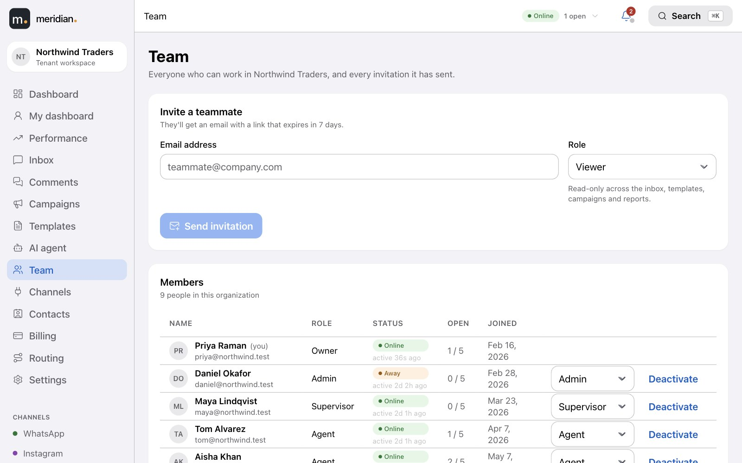
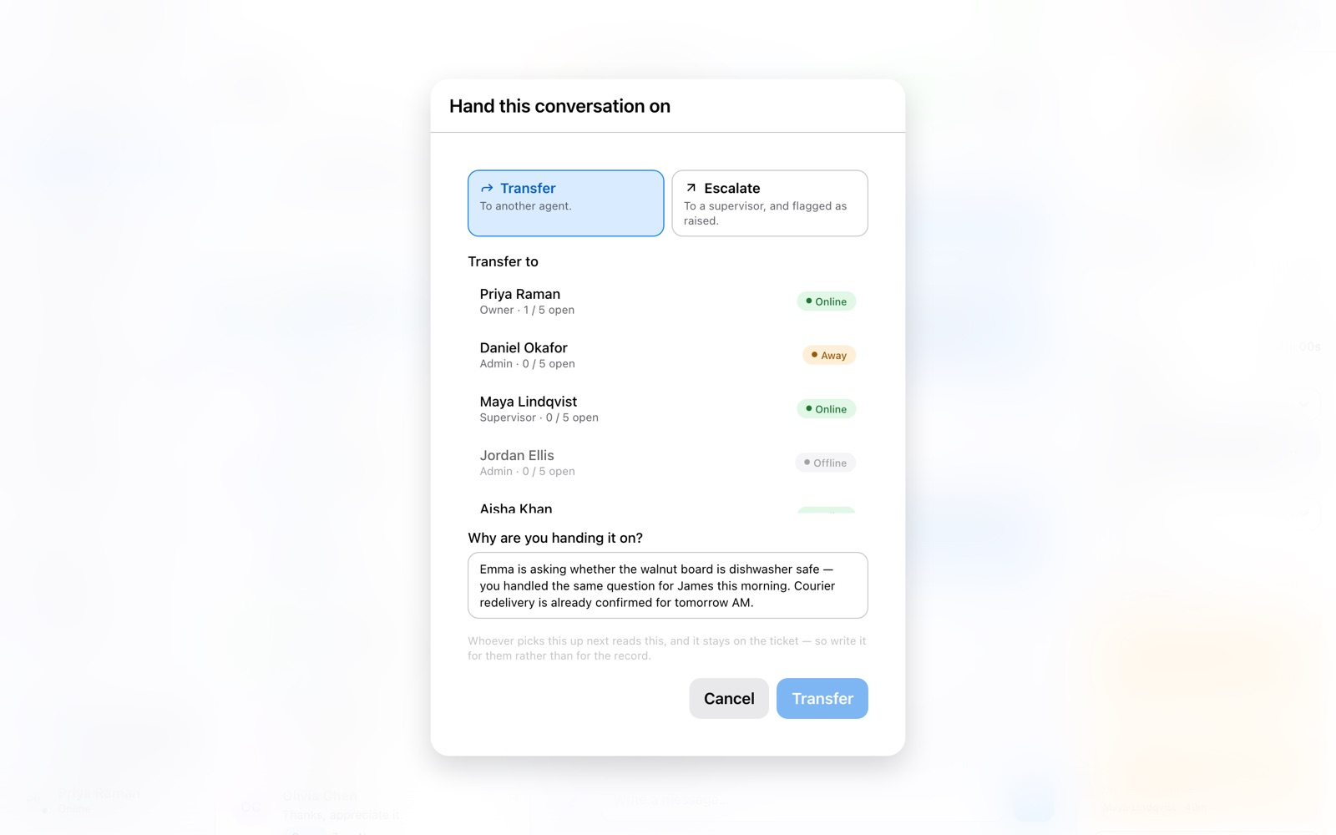
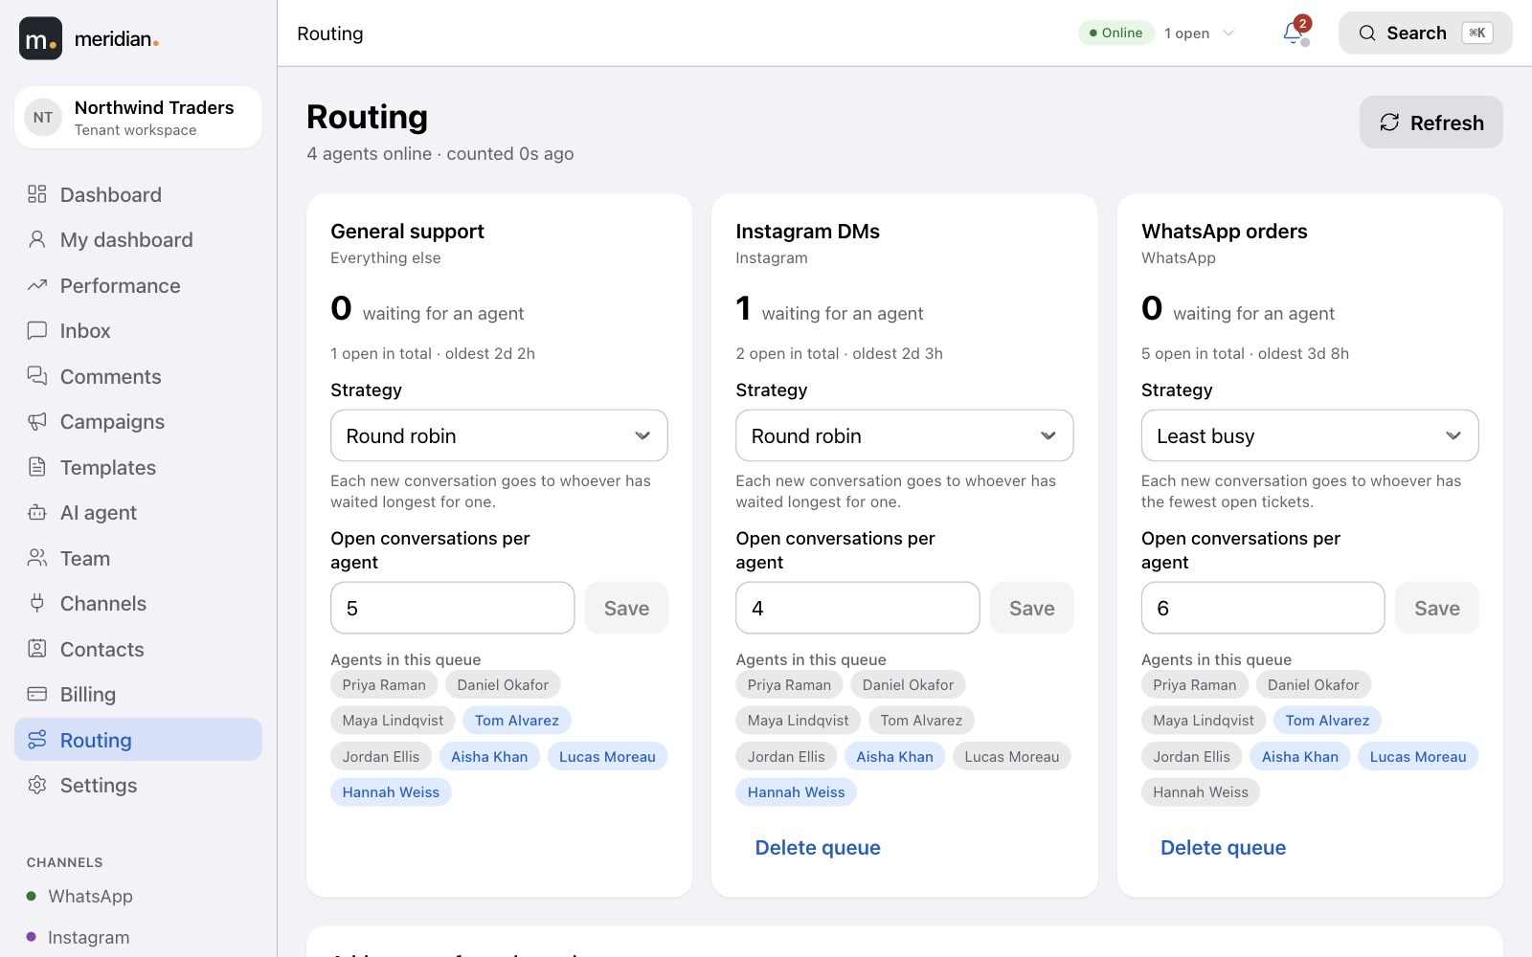
Meridian
13
YOUR TEAM
Team
Work reaches the right person, automatically.
Agents set their status; new tickets are routed round-robin or to whoever is least busy, never past an agent's limit. Supervisors see the whole floor and can reassign in a click.
Online
Away
Busy
On break
Offline
Transfer and escalate with a reason, so the next person has the story.
Transfer
Routing
Roles for everyone — owner, admin, supervisor, agent, viewer.
Going home? An agent's open tickets are handed back to the queue.
Notes:
Presence, routing strategies, concurrency caps, transfer and escalation, roles.

Slide 14
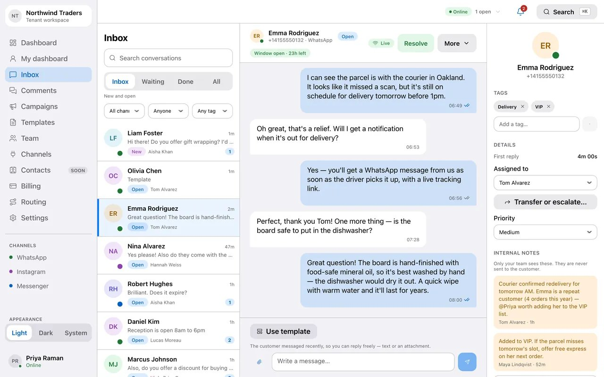

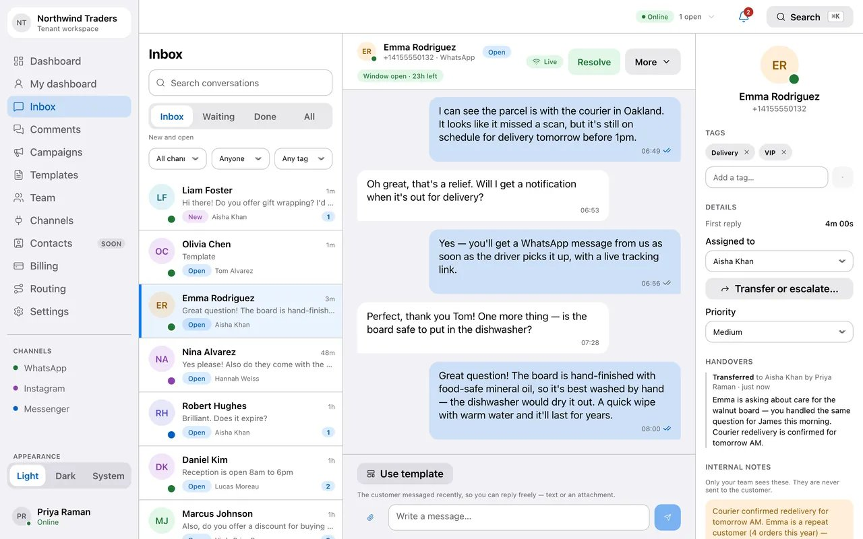
Meridian
14
SEE IT HAPPEN
Step away, hand over, come back.
An agent goes on break and comes back online; a conversation is handed to a colleague with a note, and the hand-over is recorded on the ticket.
Status menu
Transfer
Handed over
1
The agent sets their status from the top bar.
2
A conversation is transferred to a colleague with a hand-over note.
3
The ticket shows its new owner and the hand-over in its history.
Notes:
Frames captured from the running product. The web version of this deck plays the full animation.

Slide 15
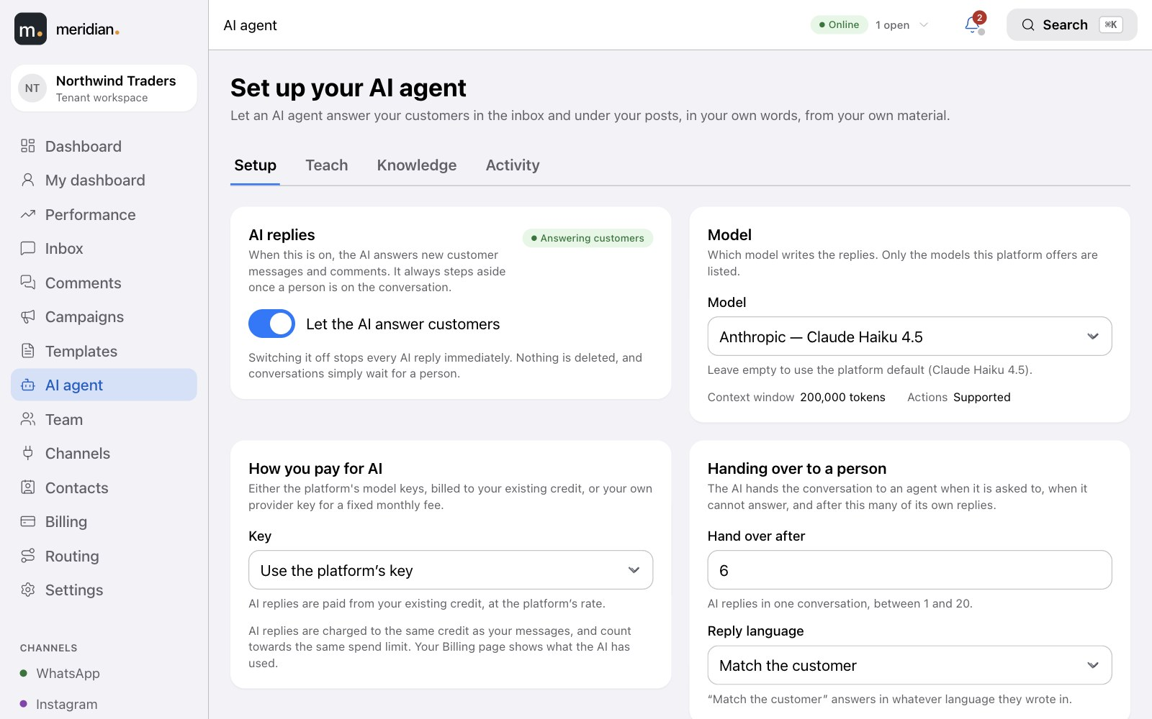
Meridian
15
NEW · AI AGENT
An AI agent that answers like your best colleague.
AI agent · Setup
Switch it on and it replies to customers in the inbox and under your posts — in your voice, from your own material — and steps aside when a person should take over.
One switch turns every AI reply off immediately. Nothing is deleted; conversations wait for a person.
Leading models from OpenAI, Anthropic, Google, DeepSeek and Moonshot — pick from the ones offered to you.
Answers in the customer's language, and hands over after the number of replies you set.
Notes:
The AI agent: a workspace switch, a model choice, how you pay, and when it hands over.

Slide 16
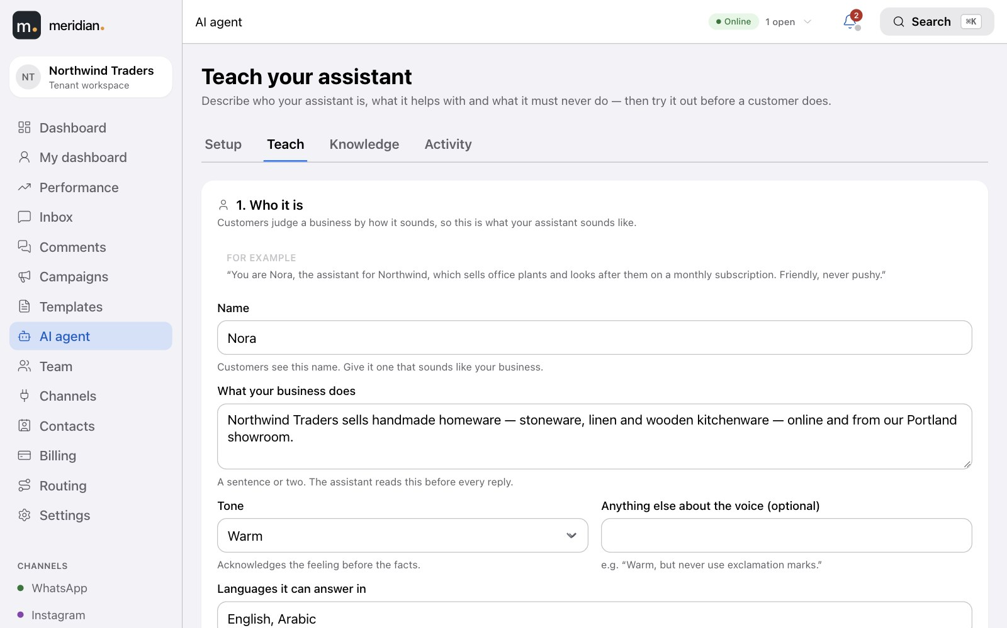
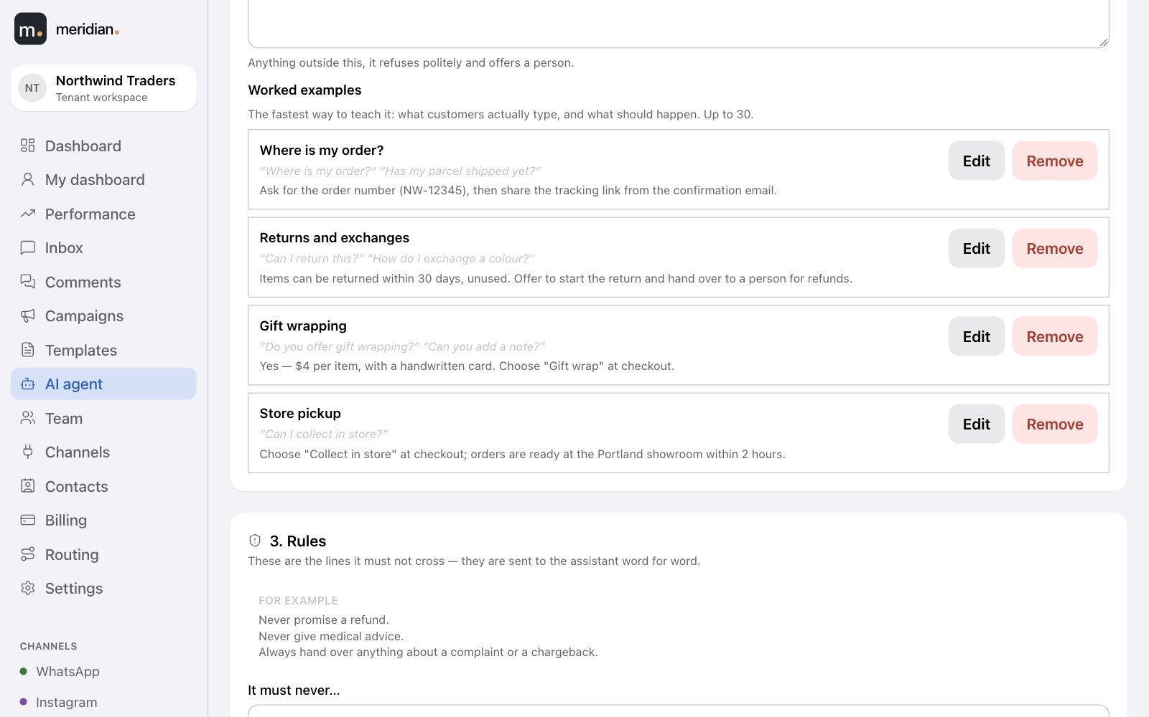
Meridian
16
AI agent · Teach
TEACH IT
Teach it like a new hire, not a prompt.
A guided page asks, in order: who it is, what it helps with, its rules, its knowledge — then lets you test it. It writes the instructions for you.
A name, a tone and a scope — anything outside it is politely refused and offered to a person.
AI agent · Worked examples
Worked examples — what customers really type, and what should happen.
Try it before a customer does — nothing in the test reaches anyone.
Notes:
The Teach page: Who it is, What it helps with, Rules, Knowledge, Test.

Slide 17
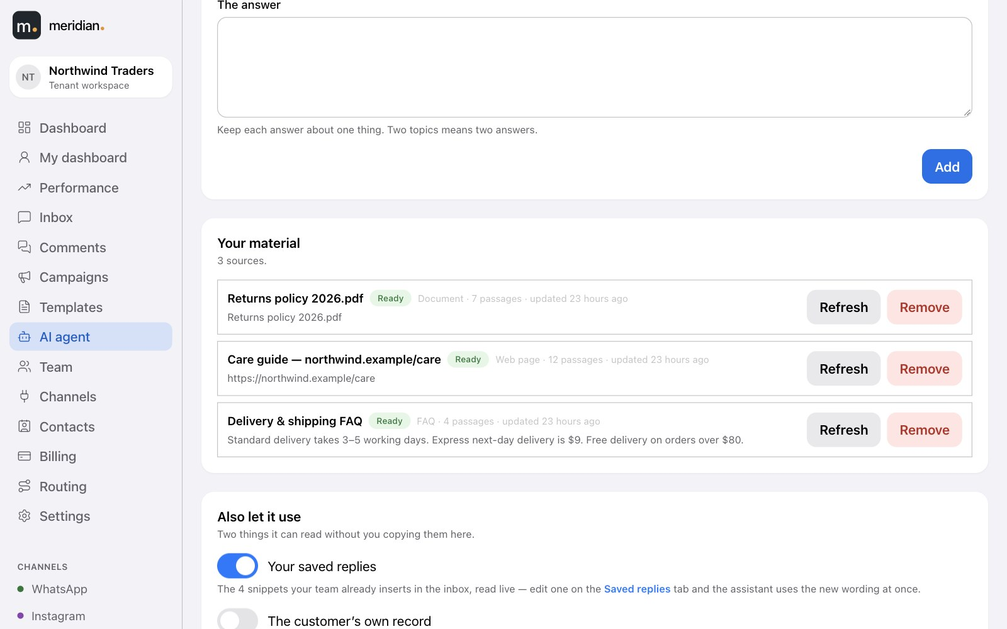
Meridian
17
KNOWLEDGE
It only says what your material says.
AI agent · Knowledge
Give it the answers you already have. It states facts it finds there — and anything it can't find, it hands to a person instead of guessing.
Write an answer, upload a file or point at a web page — PDF, Word, text and Markdown; refresh any source in a click.
Your saved replies, live — edit one and the assistant uses the new wording at once.
Your data stays yours — it never draws on another workspace's material.
Notes:
Knowledge sources: FAQs, documents, web pages, saved replies and the contact's own record.

Slide 18
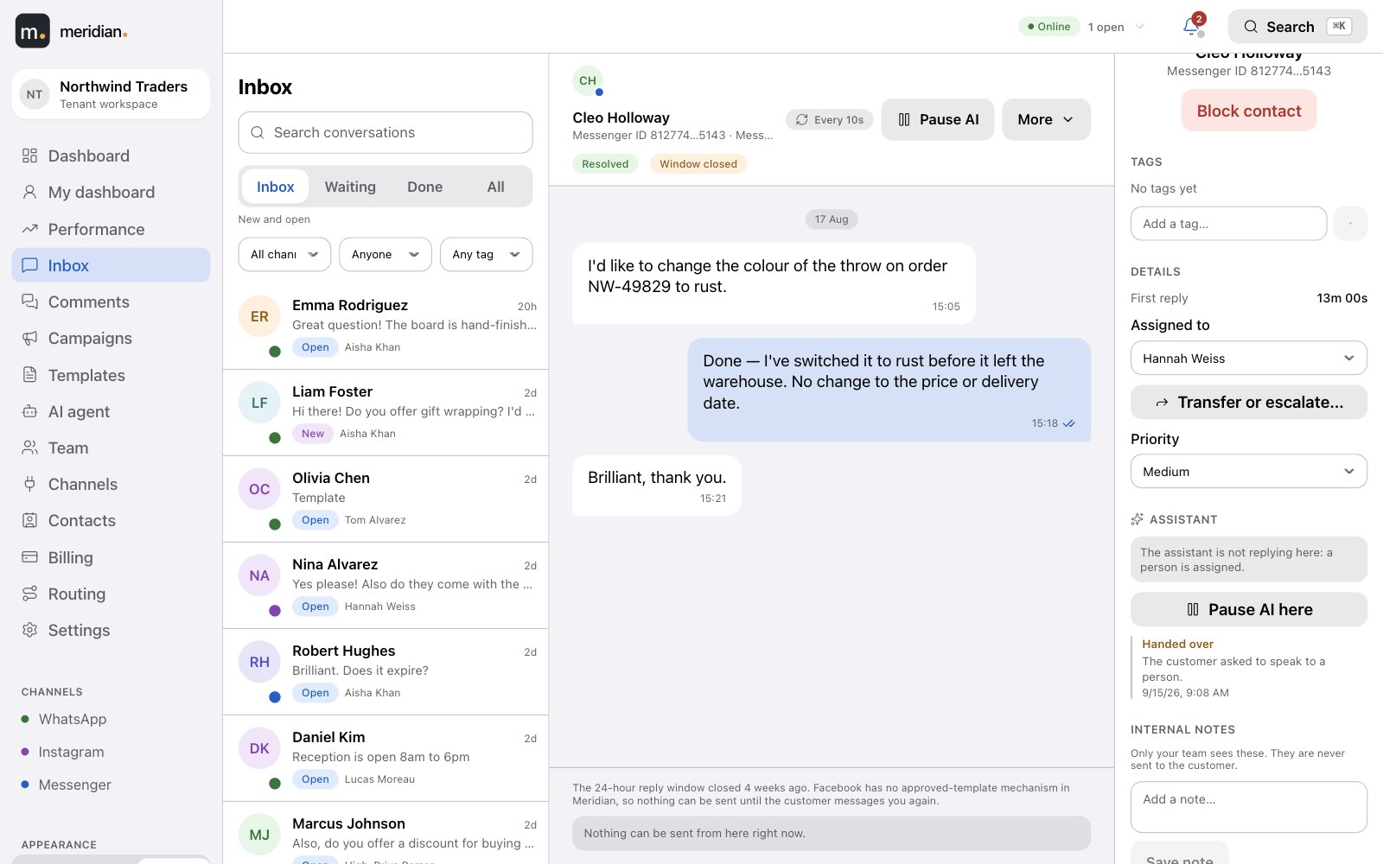
Meridian
18
ALWAYS IN YOUR CONTROL
It knows when to hand over to a person.
Inbox · Assistant handed over
It hands over when the customer asks, on an "always a person" topic, at your reply limit, when your material has no answer, or when credit runs out — with the reason on the ticket — and stays silent once a person is on it.
Pause AI here on any conversation or comment thread, and see who paused it.
Voice notes and photos — it transcribes voice notes and reads photos; videos go straight to a person.
Comments too — it can answer under your posts, publicly or privately.
Notes:
Hand-over rules, per-conversation pause, voice notes and photos, comment replies.

Slide 19


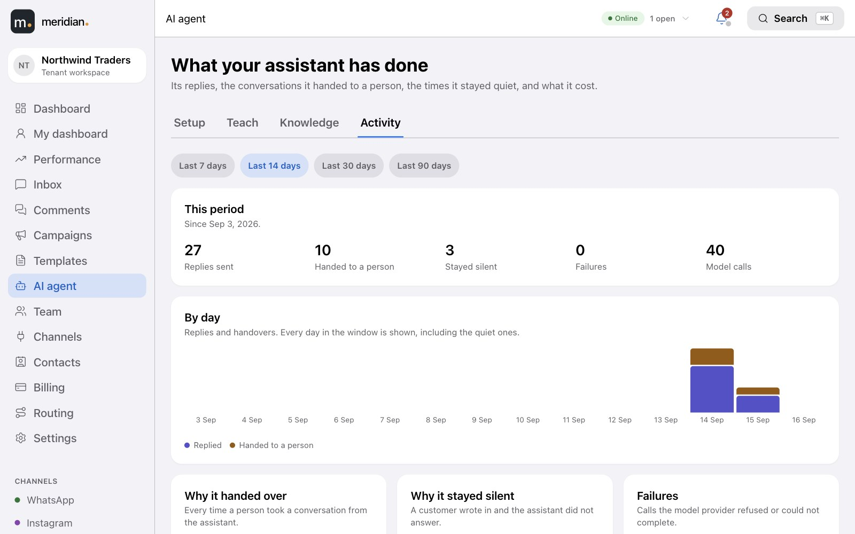
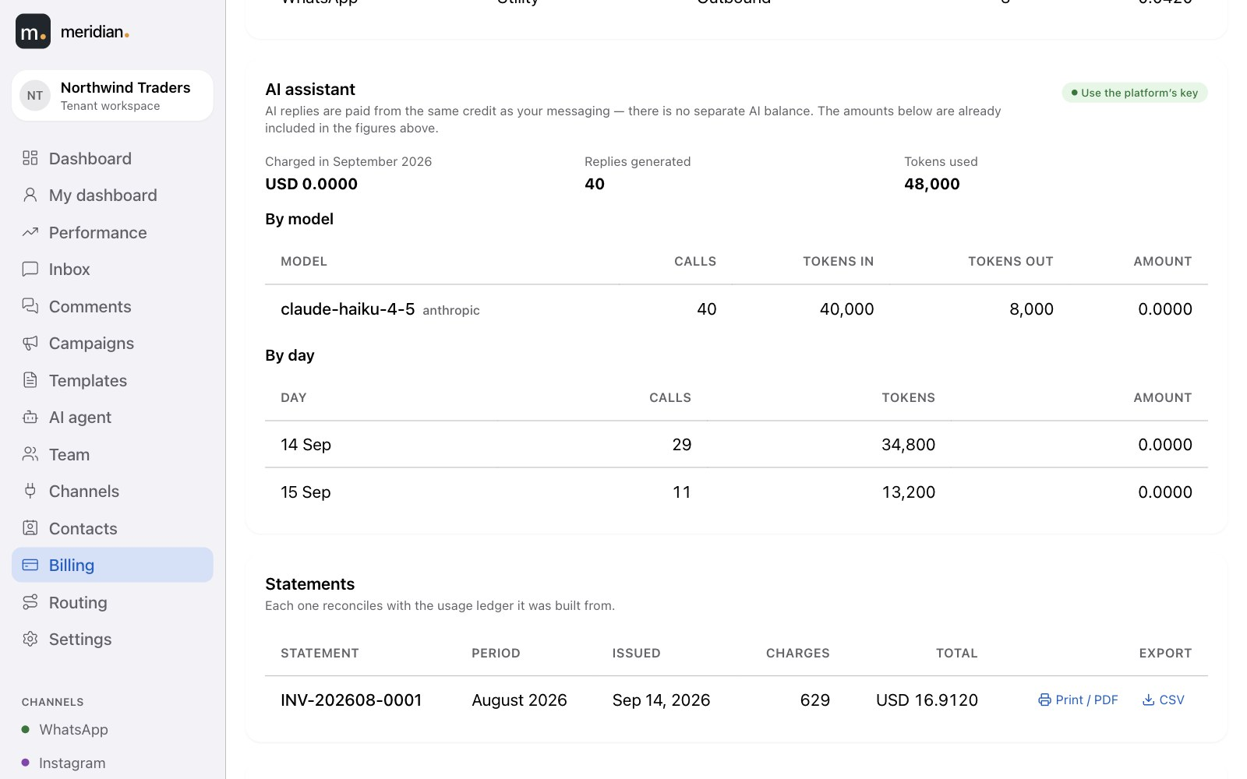
Meridian
19
ACTIVITY & COST
See everything it did — and what it cost.
Replies, hand-overs, the times it stayed quiet and why, tokens and spend by model. Pay for AI the way that suits you.
From your credit
With your own key
Use the platform's model keys. AI is paid from the same balance and spend limit as your messages — no second wallet.
Bring your own provider key and pay the provider directly, plus a fixed monthly fee on your statement.
AI agent · Activity
Billing · AI assistant
Notes:
The AI activity page and the AI section of Billing; two ways to pay.

Slide 20
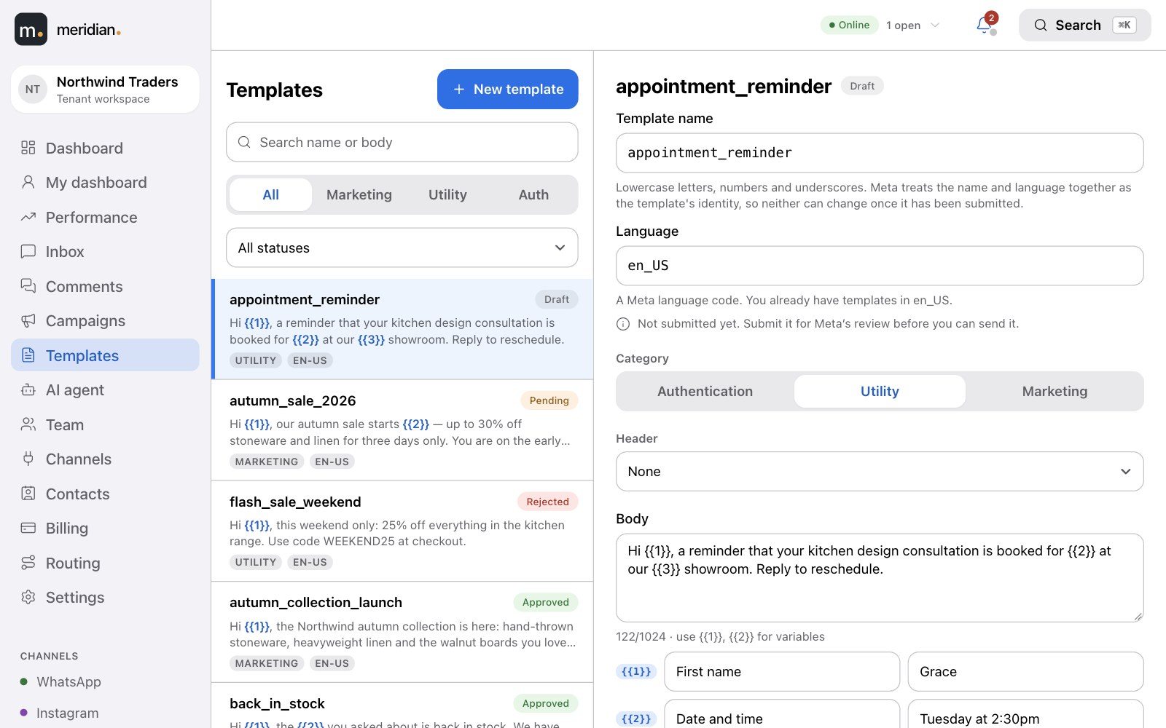
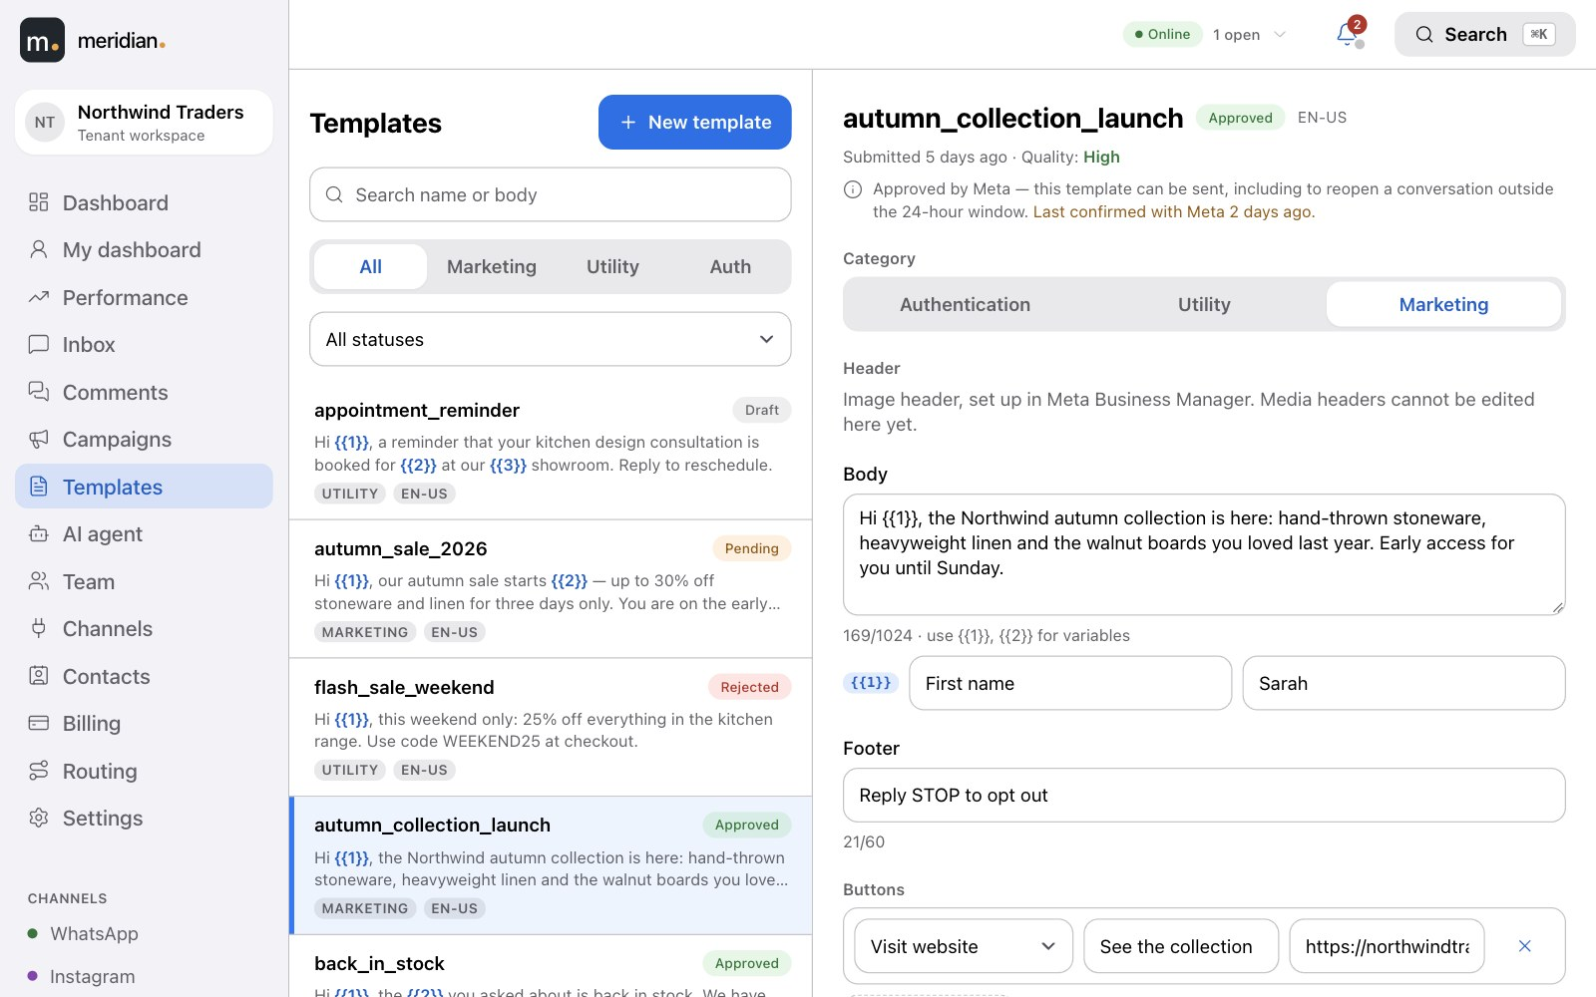
Meridian
20
Templates
TEMPLATES
Build templates here. Watch Meta approve them.
Write the header, body, footer and buttons with a live preview of exactly what the customer will see. Submit to Meta from the same screen, and the approval status updates itself.
Approved
Pending
Rejected — with the reason
Template builder
Marketing, utility and authentication categories, in any language.
Templates you created in Meta Business Manager are picked up too.
Only approved templates can ever be sent — and you choose which ones agents see.
Notes:
Templates are created in-app, submitted to Meta, and their approval status syncs automatically.

Slide 21
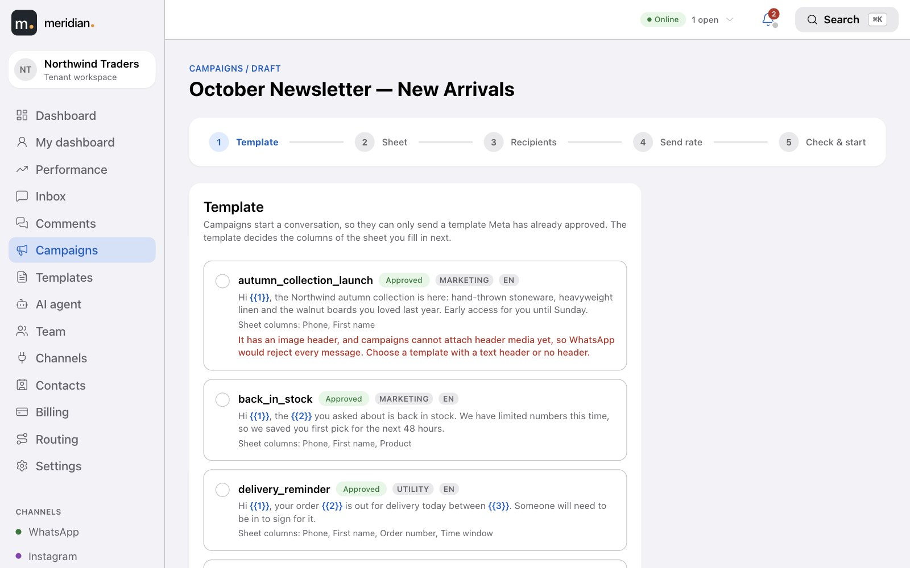
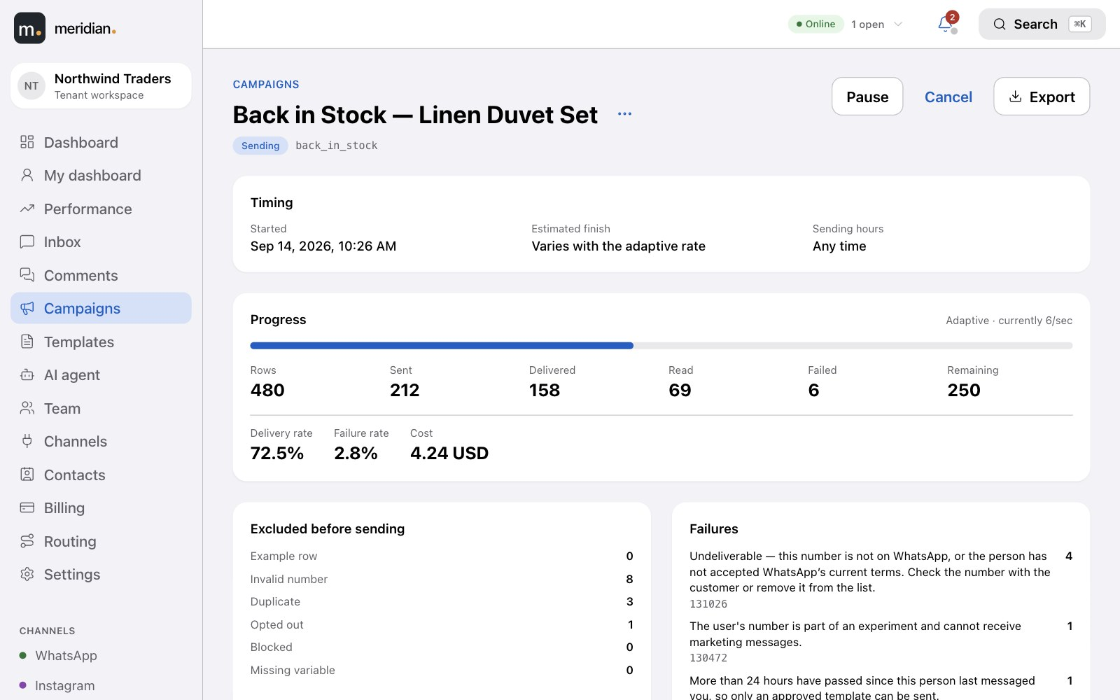
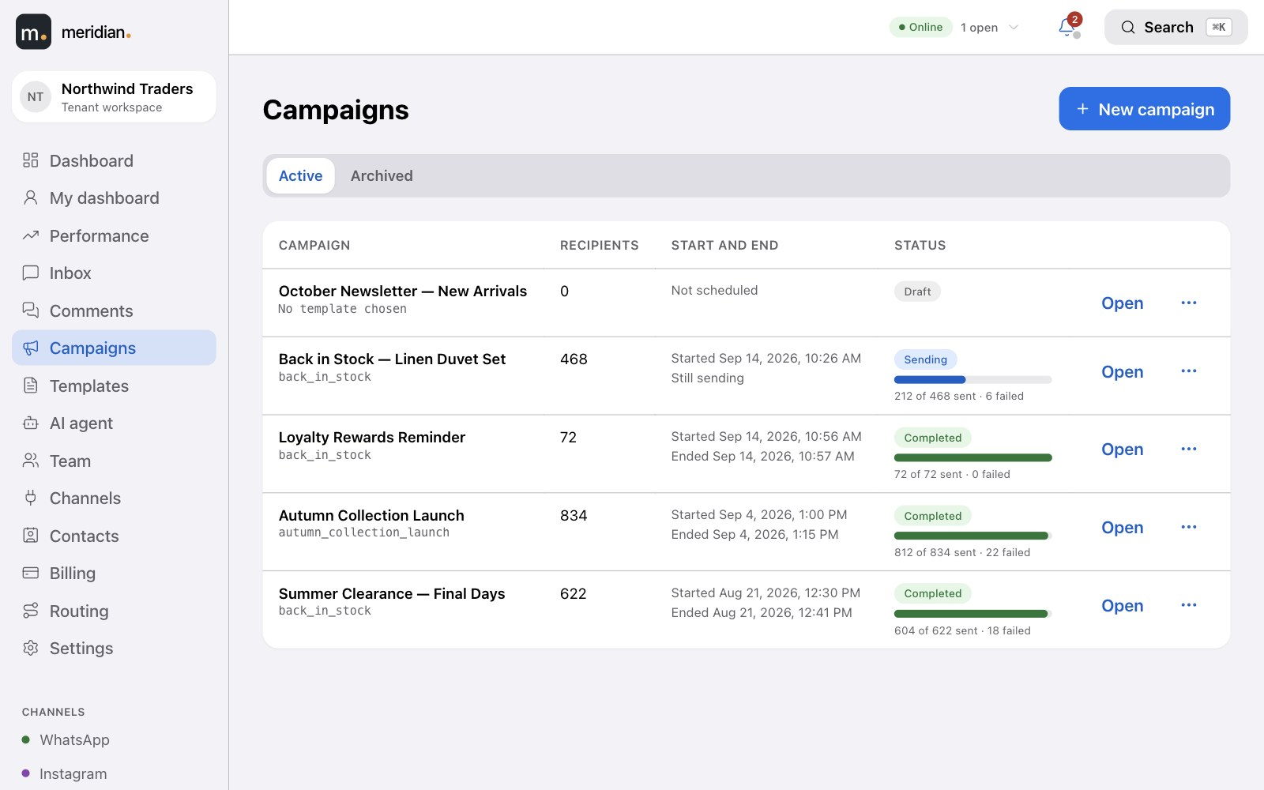
Meridian
21
CAMPAIGNS
Campaign · Choose the template
Reach thousands, when and how fast you choose.
Start from an approved template and download a sheet made for it — or pick recipients from your contacts. A check before sending says exactly what to fix.
Per second
Adaptive
All at once
Finish by
Send now or schedule it — with a start and end time, and daily sending hours.
Live progress
Campaigns
Checked before sending — invalid, duplicate, opted-out and blocked numbers are excluded.
A report for every recipient — delivered, read, failed and why, and what it cost.
Notes:
Template-first campaign builder with a pre-flight check, audiences from contacts, scheduling, four send-rate modes and sending hours.

Slide 22
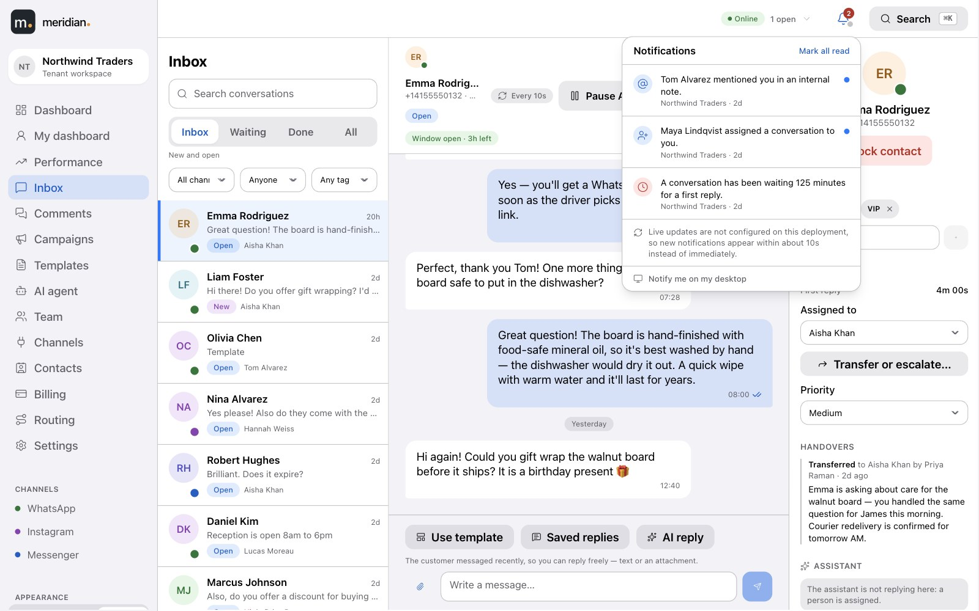
Meridian
22
LIVE
Everyone sees the same inbox, at the same moment.
Notifications
A customer's message appears for the whole team within seconds — no refreshing. Assignments, status changes and delivery updates arrive the same way.
A notification centre for what needs you, with optional browser alerts.
Email when you're offline — an assignment, a mention in a note, a response-time breach.
Honest if the connection drops — the inbox tells you, and keeps refreshing on its own.
Notes:
WebSocket updates for every agent; notification centre; email for offline agents.

Slide 23
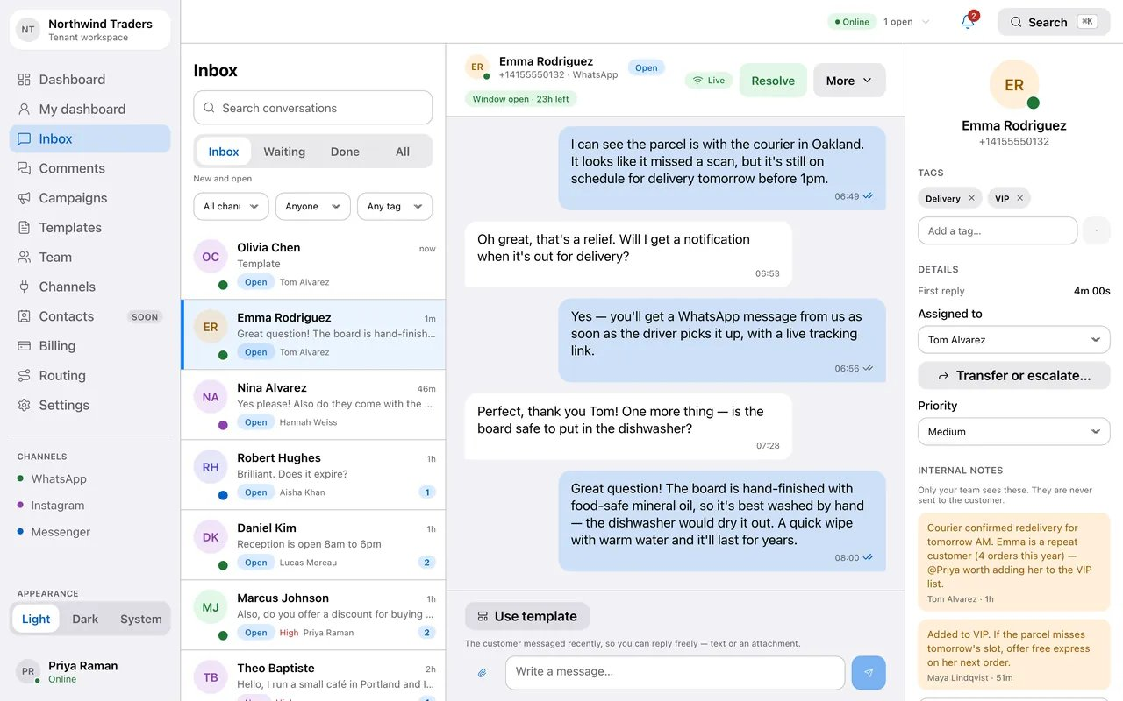

Meridian
23
SEE IT HAPPEN
A customer writes in. Everyone sees it.
A new WhatsApp message arrives and appears at the top of the inbox for the whole team, already routed to an agent — nobody refreshed anything.
Before
After
1
The inbox as the team sees it.
2
A new conversation appears at the top, routed to an agent, the moment Meta delivers it.
Notes:
Frames captured from the running product. The web version of this deck plays the full animation.

Slide 24
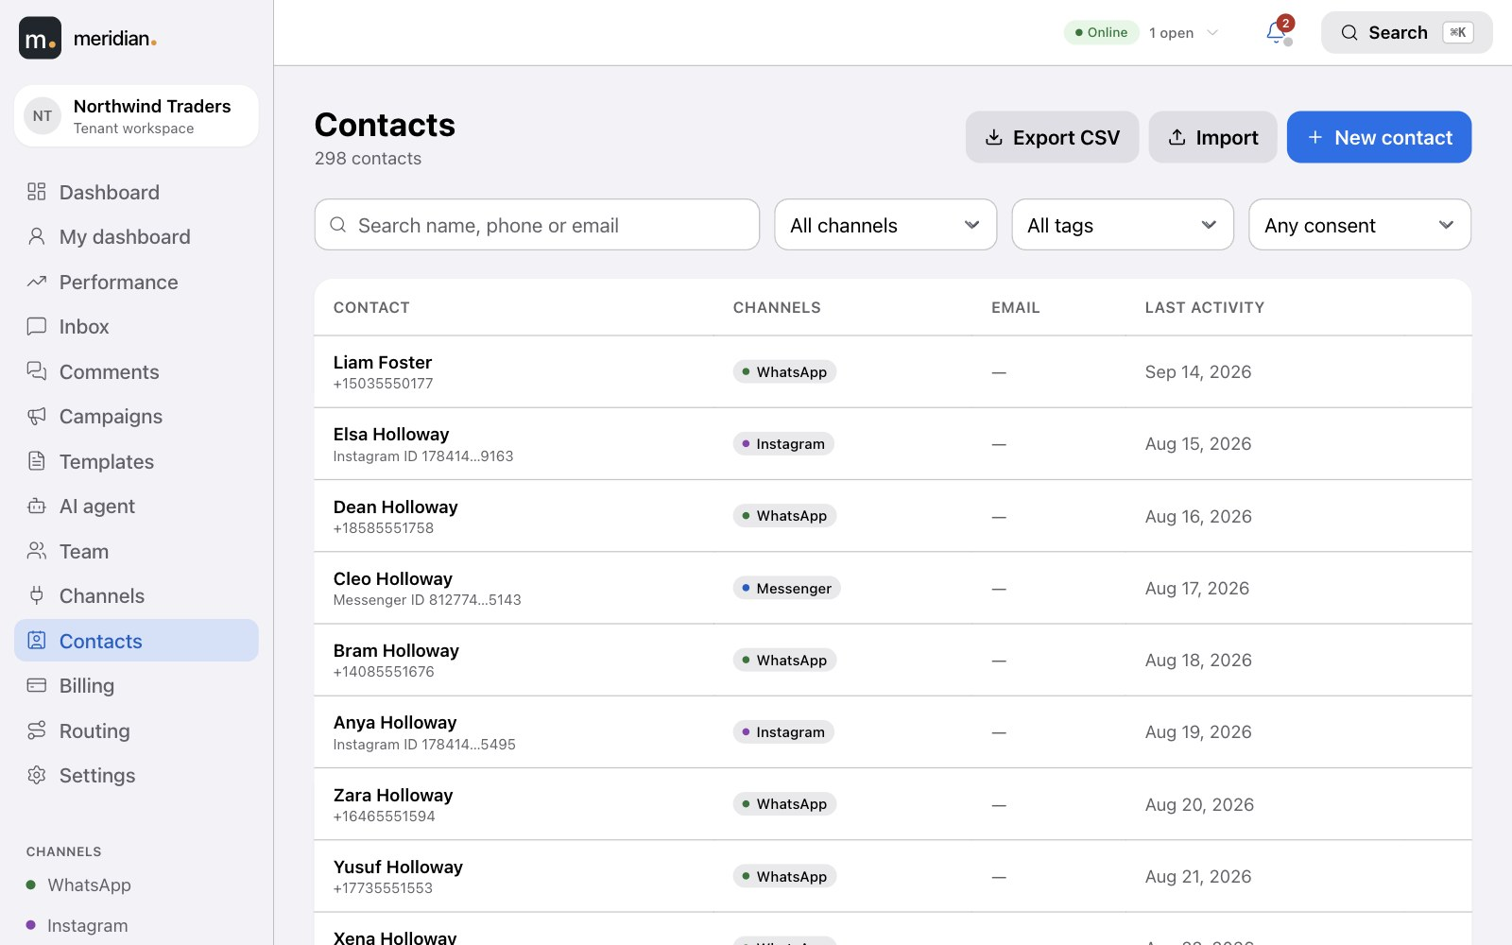
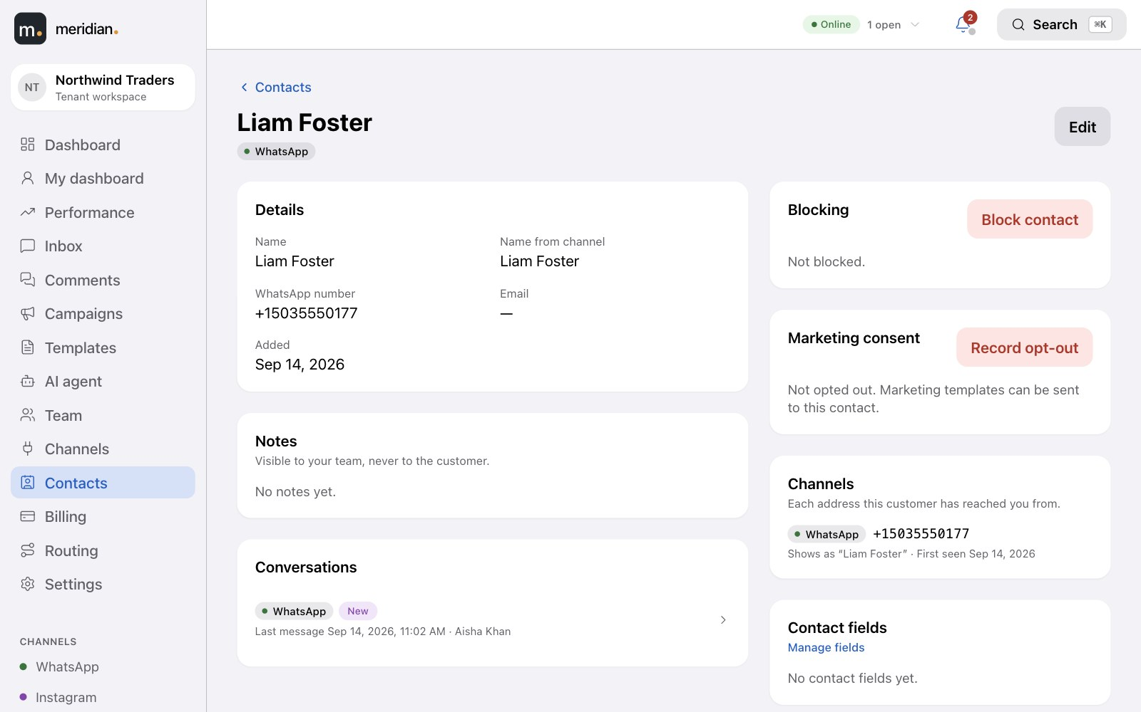
Meridian
24
NEW · CONTACTS
Contacts
Every customer, one profile.
Search and filter everyone who has reached you, by channel, tag or consent. A profile shows their details, notes and conversations across every channel.
Your own fields — a plan, a renewal date — filled in on the profile or by import, and usable to target a campaign.
Contact profile
Import and export CSV, with a report of any row that didn't make it in.
Block a contact from the inbox, comments or their profile — nothing is sent to them, and on WhatsApp the number is blocked with Meta too.
Notes:
Contacts list and profile, custom fields, CSV import and export, blocking.

Slide 25
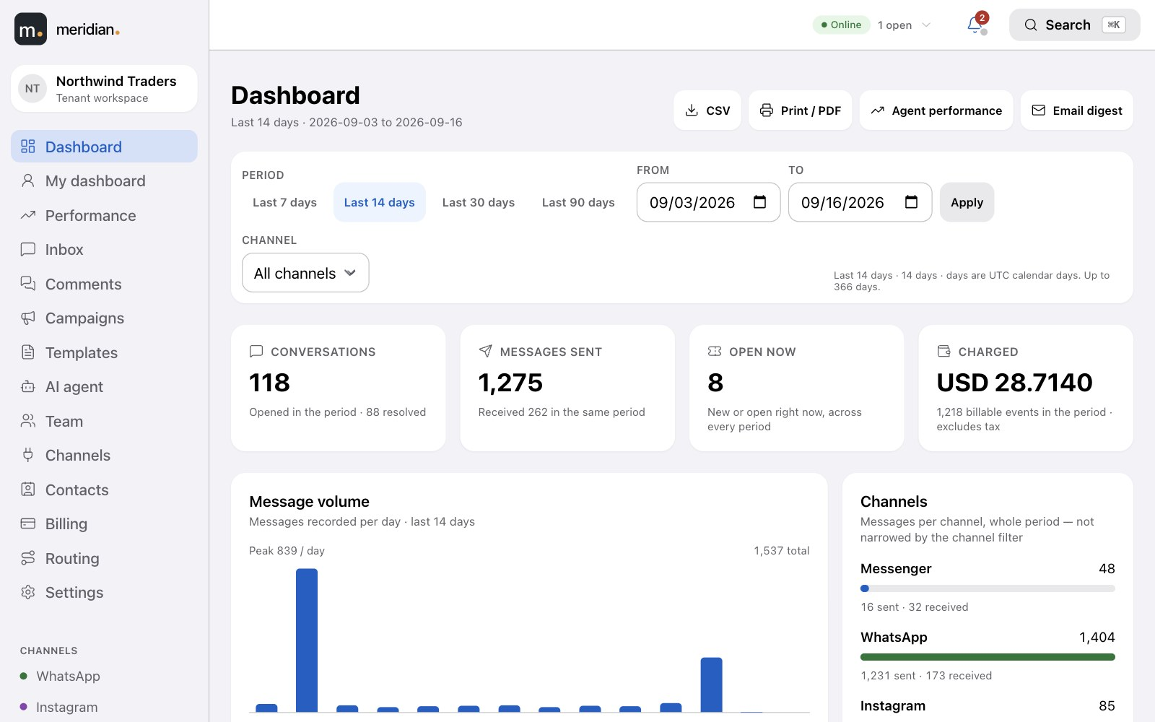
Meridian
25
REPORTS
The numbers that matter, straight from your conversations.
Dashboard
Message volume by channel, first-response and resolution times, open versus resolved tickets, campaign results and what the period cost — for any date range, exportable to CSV.
Each agent has their own view — their queue, their response times.
Scheduled email digests for anyone who opts in.
Every figure reconciles to the underlying messages — nothing estimated.
Notes:
Dashboards reconcile exactly with the underlying message and billing records.

Slide 26
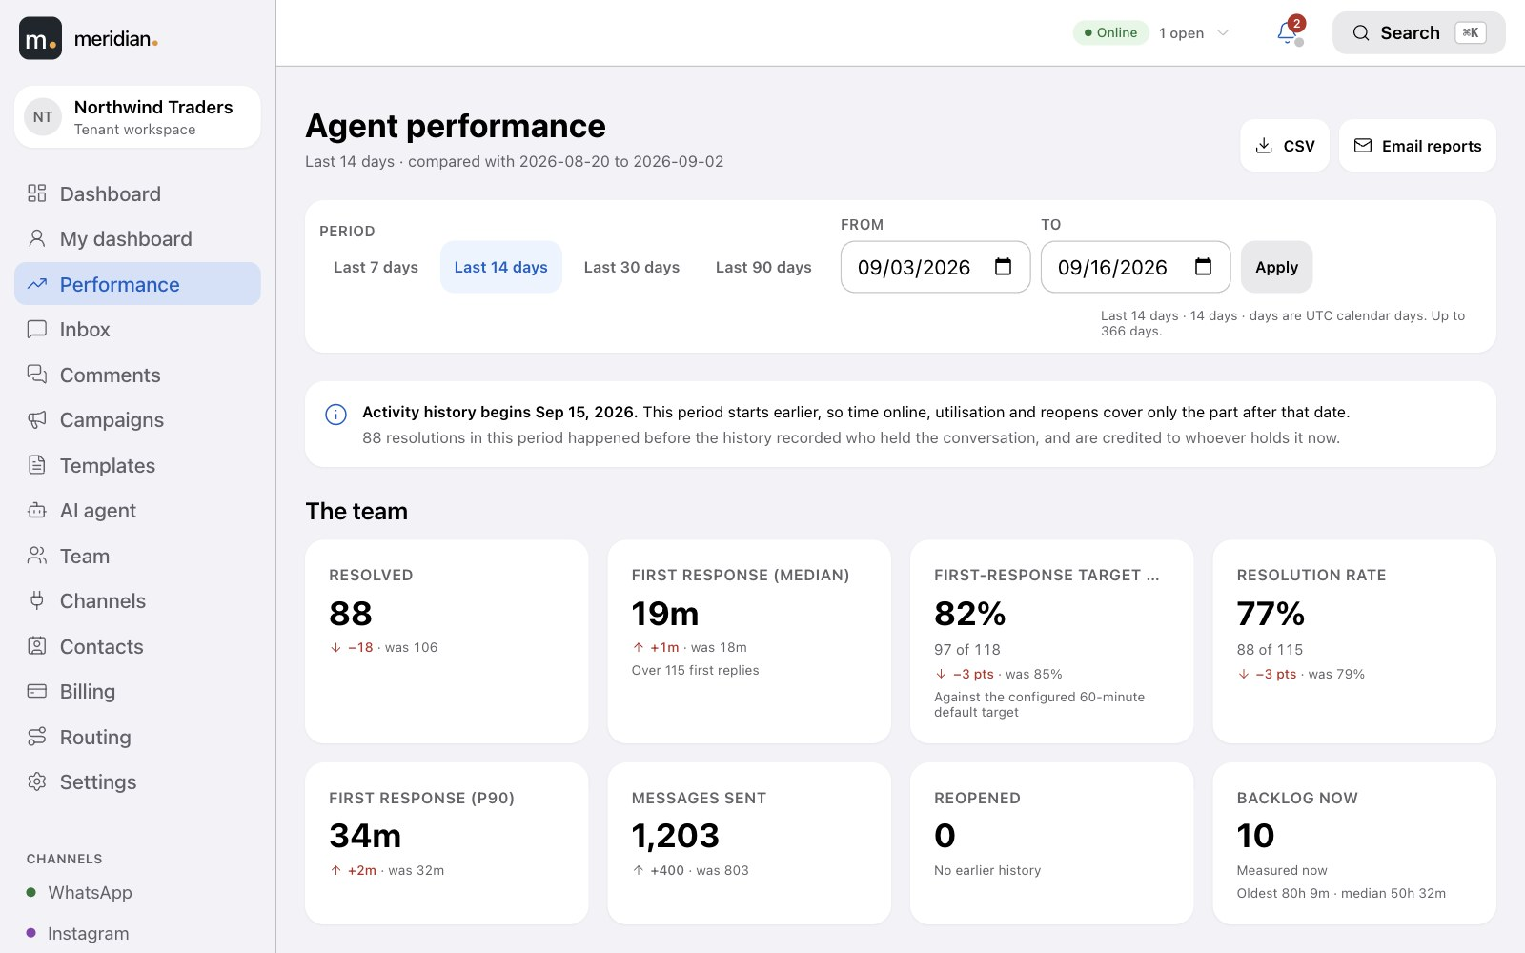
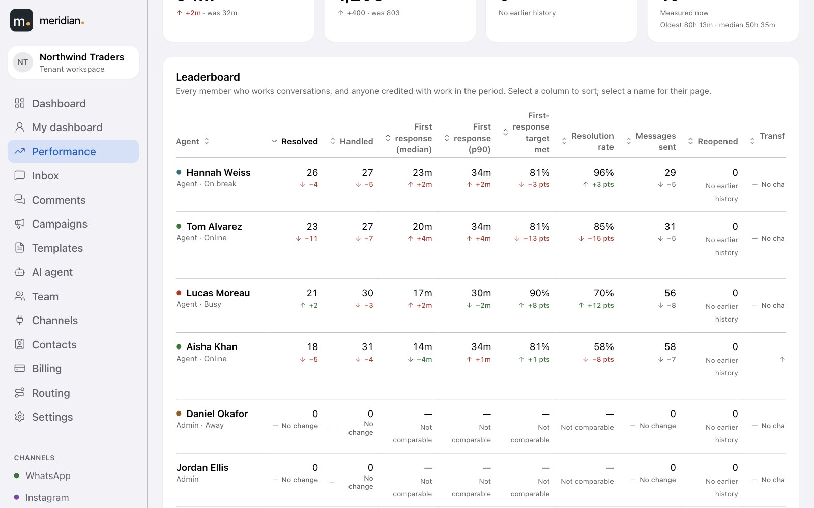
Meridian
26
Performance · The team
NEW · PERFORMANCE
Know how every agent is doing.
Speed, outcomes, workload and availability for the team and for each person — every figure compared with the period before.
First response and resolution times, response-target compliance, resolution rate, transfers and reopens.
Performance · Leaderboard
A leaderboard and a page per agent, with trends, backlog and time online, away and on break.
Export to CSV or email it on a schedule.
Notes:
Agent KPIs, leaderboard, per-agent drill-down, CSV and scheduled email reports.

Slide 27



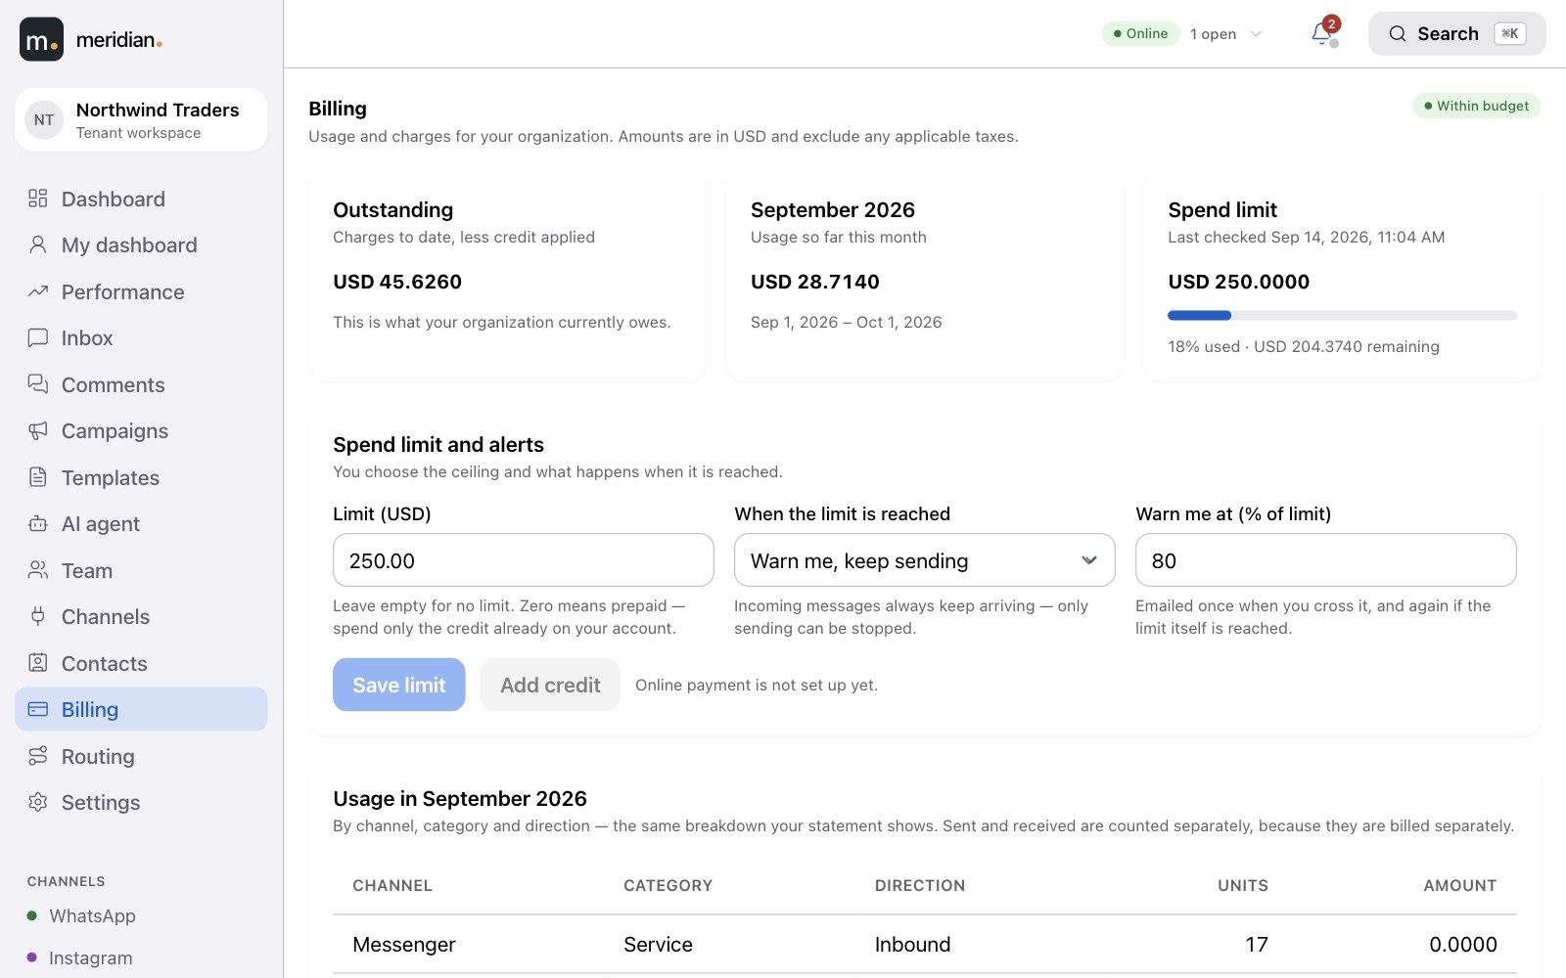
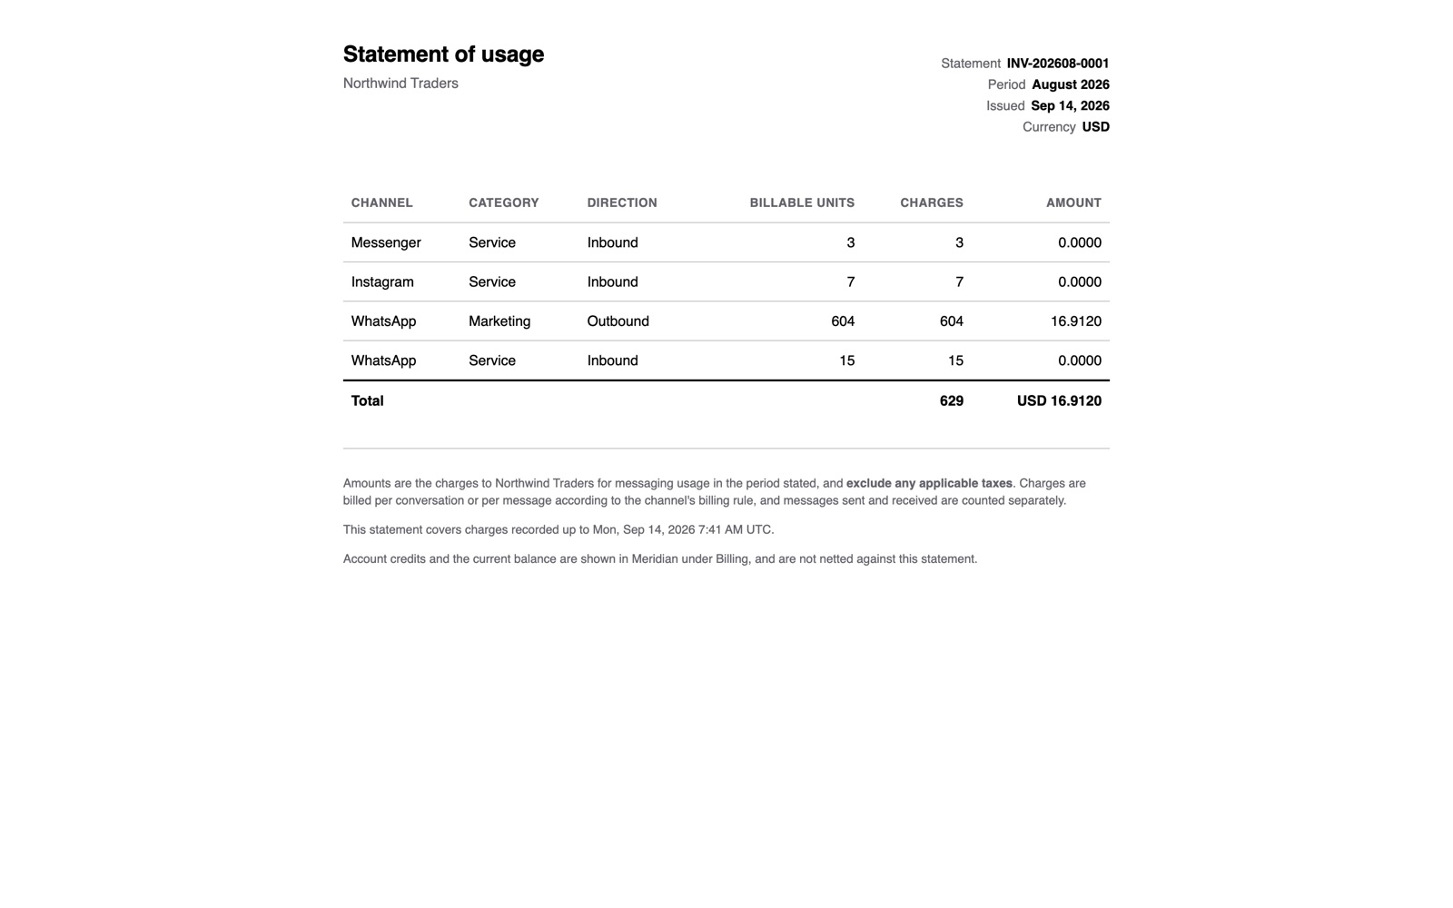
Meridian
27
BILLING
Pay per message. See every one of them.
You are charged per message sent and received, and for AI replies from the same balance. Your usage, your spend limit and your monthly statement are all in the app — no surprises.
Usage, itemised
A spend limit you set
Monthly statements
Messages by channel and conversation type, and AI usage by model and by day.
Be warned, or pause sending, at the limit. Out of credit, the AI hands over to a person.
A statement of usage each month that matches your ledger exactly, ready to download.
Billing
Statement of usage
Notes:
Per-message billing with itemised usage, a configurable spend limit and monthly statements.

Slide 28
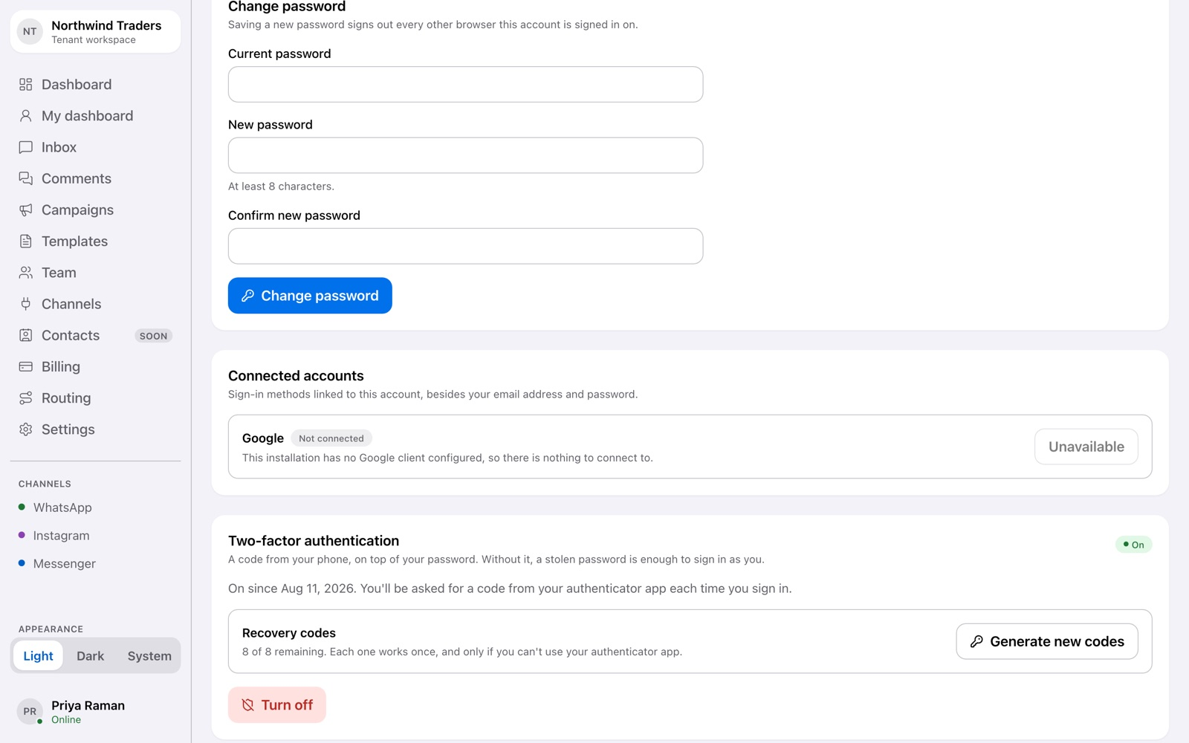
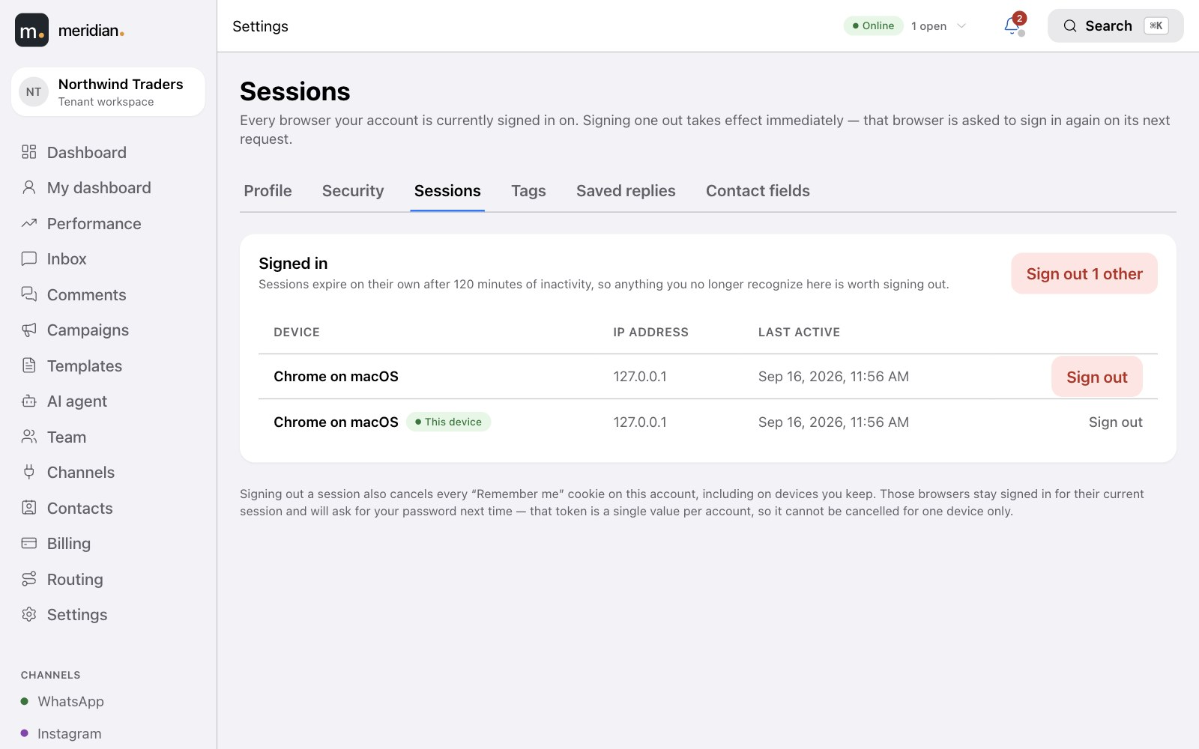
Meridian
28
Settings · Security
SECURITY & CONTROL
Your data, your team, your rules.
Two-factor authentication with recovery codes; see and sign out every active session.
Five roles so agents see conversations, and only owners and admins see credentials and billing.
Settings · Sessions
An audit trail of sensitive changes — who changed what, and when.
Opt-outs honoured automatically — a customer who replies STOP is never sent marketing again.
Data export and deletion on request, with configurable retention.
Notes:
2FA, session management, roles, audit trail, opt-out compliance, data export/deletion.

Slide 29
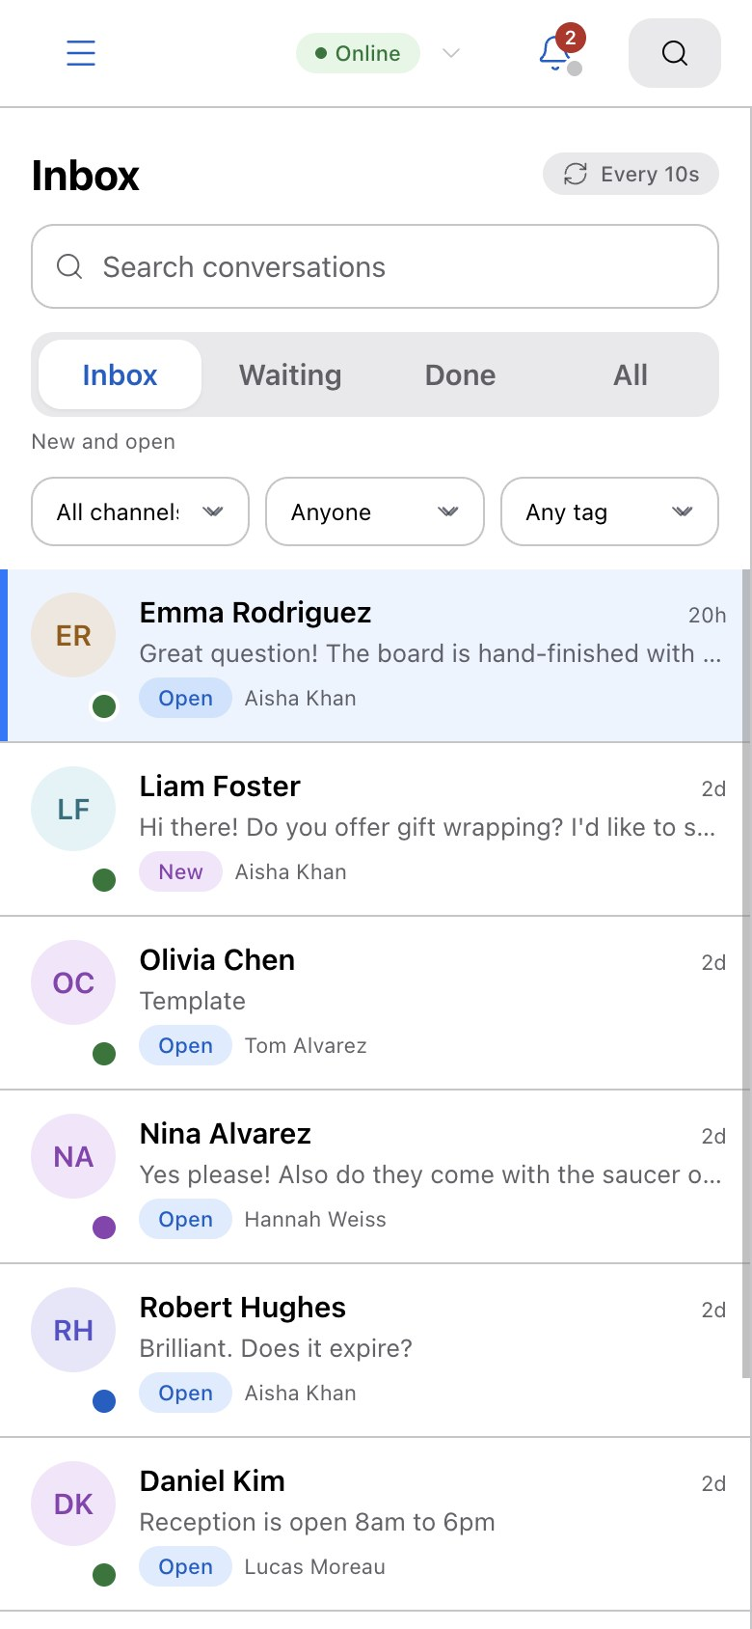
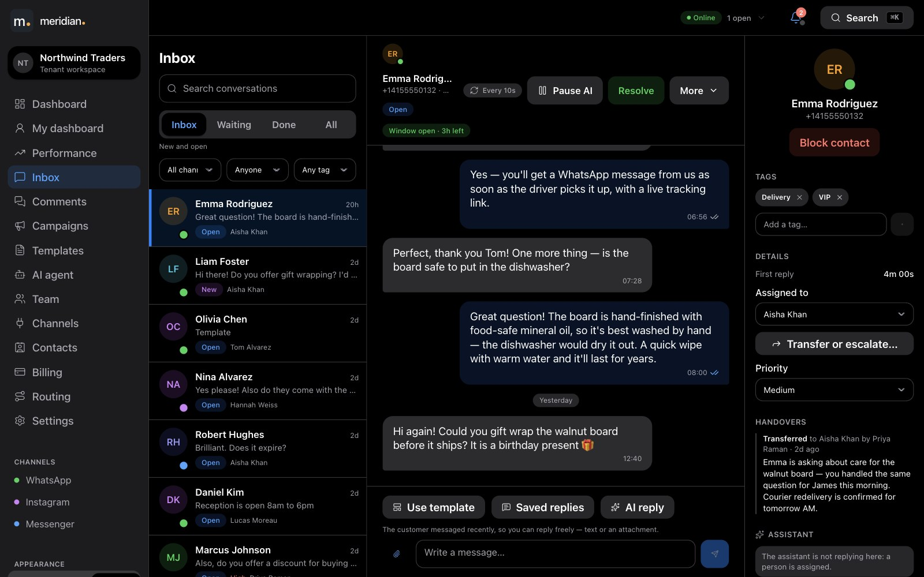
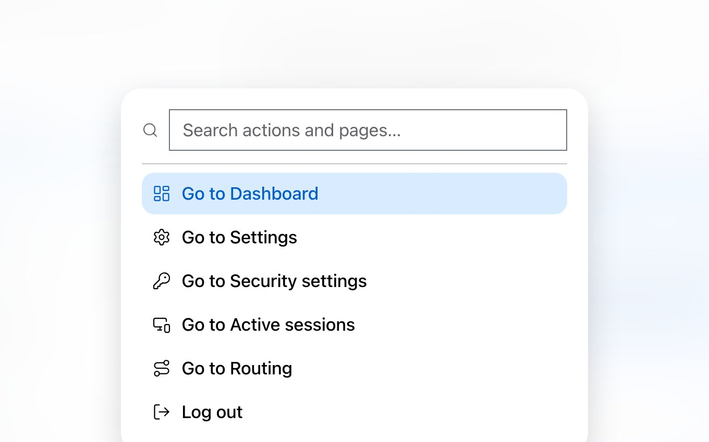
Meridian
29
EVERYWHERE
Light or dark. Desk or phone. Mouse or keyboard.
Inbox · Dark
⌘K
⌘K jumps anywhere.
Works on a phone.
Dark mode, or follow your system setting.
Notes:
Light and dark modes, responsive on mobile, and a command palette for keyboard users.

Slide 30
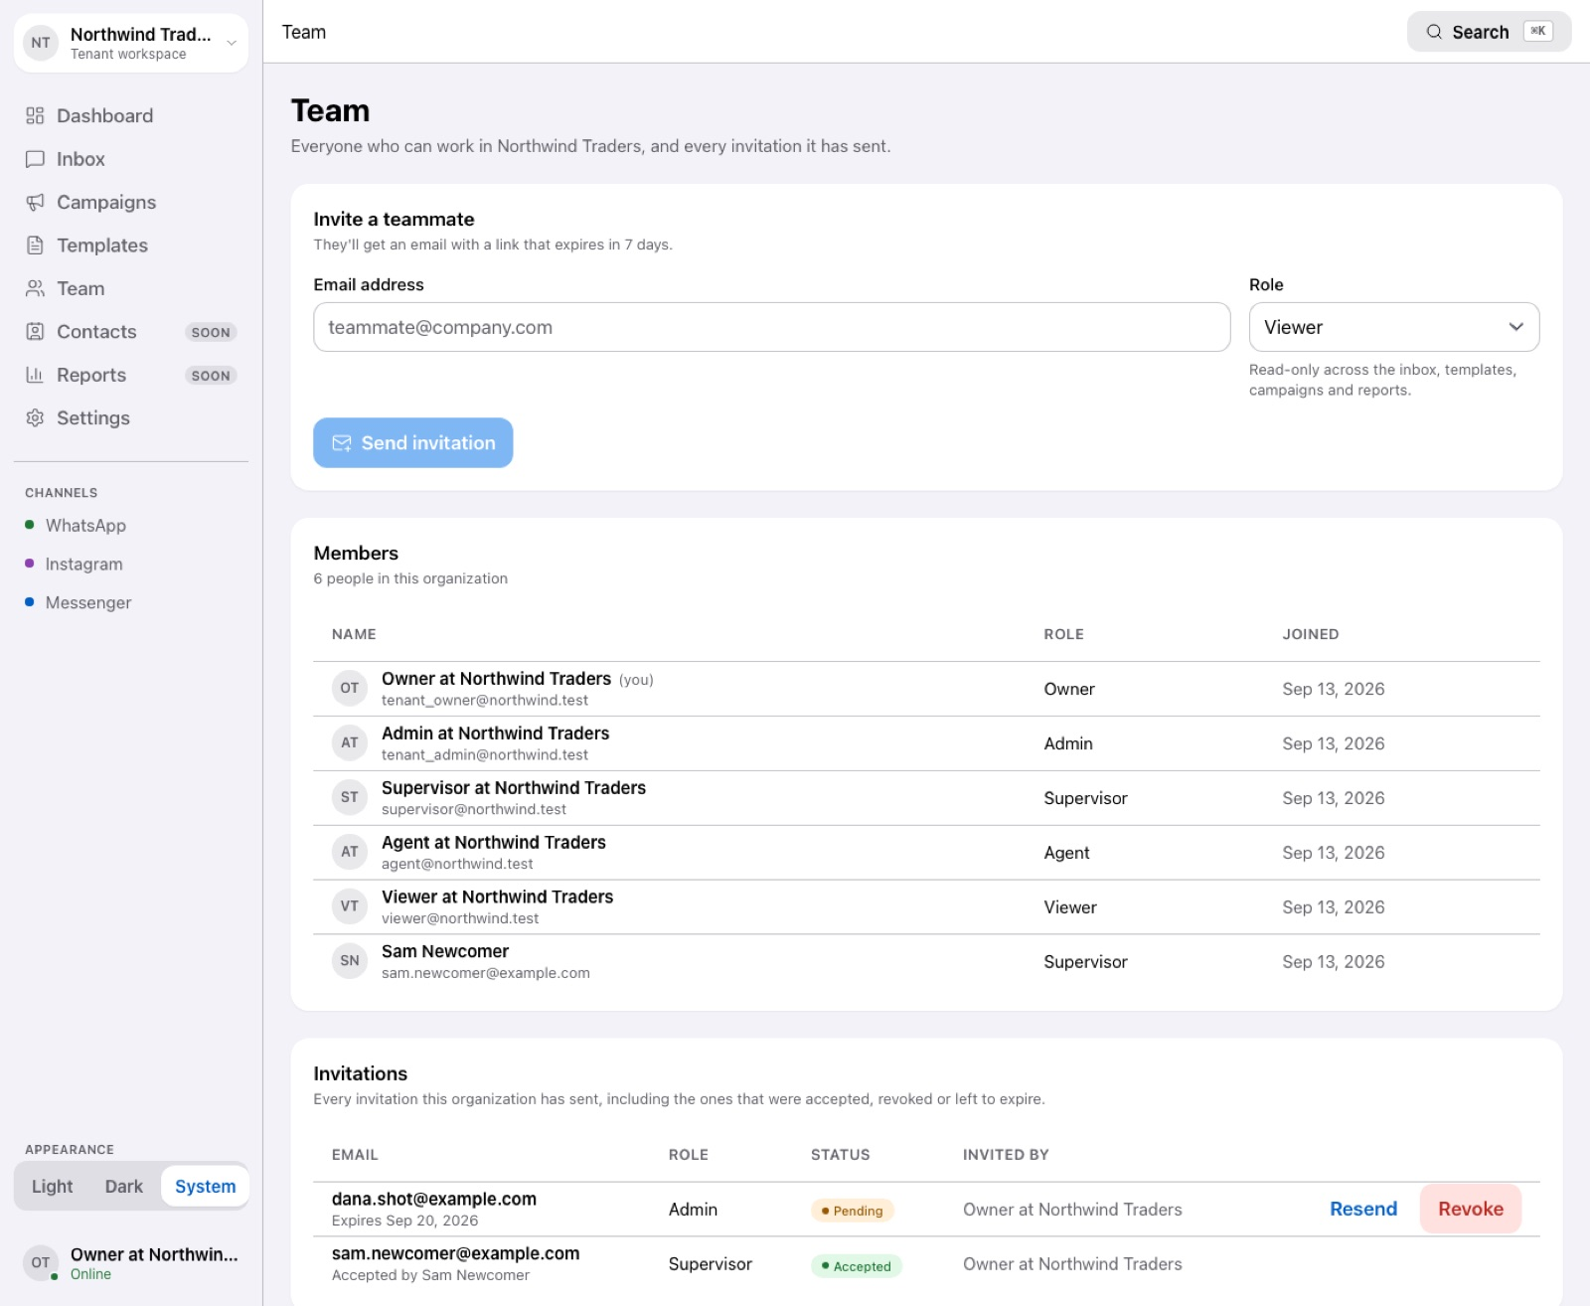
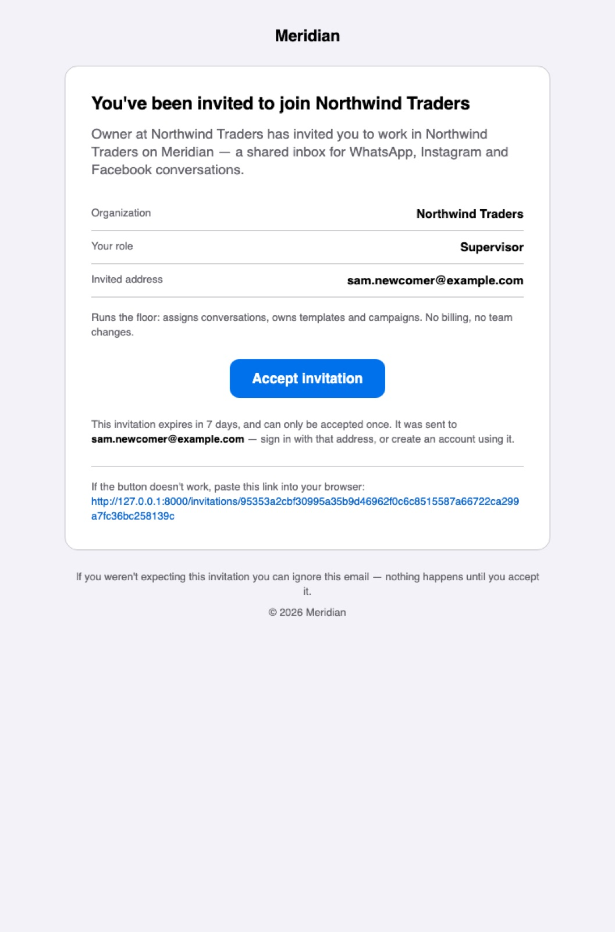
Meridian
30
GETTING STARTED
Live in an afternoon.
1
2
3
4
5
6
Sign in
Add channels
Invite your team
Create templates
Teach your AI
Start answering
With Google or an email address.
WhatsApp, Instagram and your Facebook Page, guided step by step.
Each person gets an email and the role you chose.
Submit to Meta and wait for the green badge.
Optional: a voice and your material, tested, then on.
Messages route to your agents from the first minute.
Team
Invitation email
Notes:
Six steps from sign-up to answering customers; teaching the AI agent is optional.

Slide 31
Meridian
31
Meridian
One inbox for WhatsApp, Instagram and Messenger — with an AI agent, contacts, tickets, templates, campaigns and reporting to run support on them.
WhatsApp
Instagram
Messenger
AI agent
Notes:
Thank you.

